Slide 1


DEPARTMENT OF COMPUTER ENGINEERING
WELCOMES
NBA TEAM

Slide 2
Outline
About Department
Achievements: Department, Student
Vision, Mission and Program Educational Objectives
Program Curriculum and Teaching-Learning Processes
Program Outcomes and Course Outcomes
Students’ Performance
Faculty Information and Contributions
Facilities and Technical Support
Continuous Improvement
2

Slide 3
About Department
Programme | Specialization | Intake | Year of Establishment | Affiliated | Approved | NBA Accreditation
UG | Computer Engineering | 240 | 1991 | Savitribai Phule Pune University | AICTE | 2003,2007,2013,2016 & 2019 (extension)
PG | CSE | 06 | 2002 | Savitribai Phule Pune University | AICTE | 2007
Current Status : Department Faculty
Ph.D : 11 Professors : 03
Masters : 27 Associate Professors : 03
Faculty pursuing Ph.D : 15 Assistant Professors : 43
Student Strength (UG)
Class | Strength
SY | 275
TY | 333
B.Tech | 334
Total | 942
3

Slide 4


Department Achievements/Recognitions
Highest Placement Package
45
LPA
International Awards & achievement (26)
INational Awards & achievement(32)
Winner
Research Funds
78.57L
134
Total Publications(SCI, Scopus, IEEE conference ,Book Chapters etc.)
Achievements
Entrepreneurs
08
34
Copyrights/Patent
92%
16
Placement Percentage
Faculty Awards
4

Slide 5




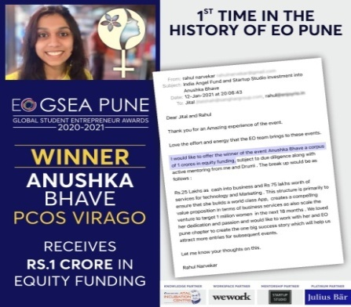









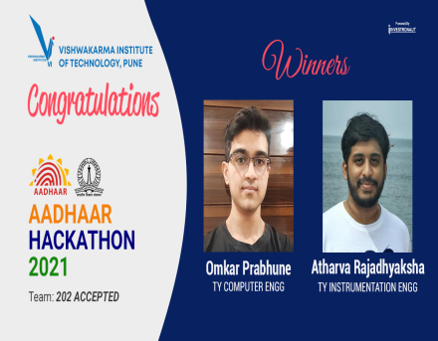
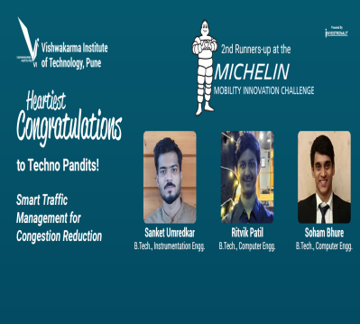
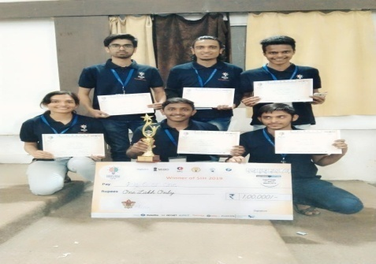

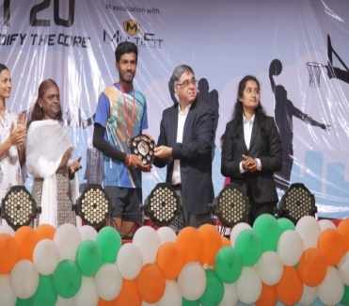
Student Achievements/Recognitions
International Level
Anushka Bhave -Regional Winner & 2nd Runner Up at Global Student Entrepreneur Awards, by
Entrepreneurs Organisation (USA)
SIGCHI Development Fund Grant in HCI from ACM SIGCHI, International symposium –Asian CHI 2021, Japan
Z-Hacks! - International Level Hackathon
HackNYU- NewYork University and sponsered by Meta(face book) Walt disney and
Aditi Badgujar - Best verbal commendation United Nations Development Program
National Level
Smart India Hackathon 2019 sponsored by MHRD Zaid Naikwadi, Akshay Akole , Kamlesh Shilag, Fagun Shadi and their team won the prize of 1 Lakh rupees
Onkar Prabhune - AADHAR HACKATHON 2021
2nd Runner up position at the Michelin Mobility Innovation Challenge 2021
Runner up in
Kata Thon – Vedangi Deshpande & Kalash Nikose
Winner – MIT’s Summit
Rishikesh Lenekar
6

Slide 6
Vision, Mission
Program Educational Objectives

Slide 7

Vision & Mission
Institute Vision
"To be globally acclaimed Institute in Technical Education and Research for holistic Socio-economic development“
Institute Mission
To ensure that 100% students are employable and employed in Industry, Higher Studies, become Entrepreneurs, Civil / Defense Services / Govt. Jobs and other areas like Sports and Theatre
To strengthen Academic Practices in terms of Curriculum, Pedagogy, Assessment and Faculty Competence
Promote Research Culture among Students and Faculty through Projects and Consultancy
To make students Socially Responsible Citizen
Department Vision
"To be a leader in the world of computing education practicing creativity and innovation“
Department Mission
To ensure students' employability by developing aptitude, computing, soft, and entrepreneurial skills
To enhance academic excellence through effective curriculum, blended learning and comprehensive assessment with active participation of industry
To cultivate research culture resulting in knowledge-base, quality publications, innovative products and patents
To develop ethical consciousness among students for social and professional maturity to become responsible citizens
7

Slide 8
Programme Educational Objectives (PEOs)
PEO | PEO Focus | PEO Statement
PEO1 | Preparation | Demonstrate application of sound engineering foundations to be a committed technology workforce
PEO2 | Core competence | Apply mathematical and computing theory knowledge base to provide realistic computer engineering solutions
PEO3 | Breadth | Exhibit problem solving skills and engineering practices to address problems faced by industry with innovative methods, tools and techniques
PEO4 | Professionalism | Develop professional and ethical practices adopting effective guidelines to acquire desired soft skills in societal and global context
PEO5 | Professionalism | Aim for continuing education and entrepreneurship in emerging areas of computing
8

Slide 9
Vision, Mission & PEOs Dissemination
Maintained in the MASTER FILE of Head of the Department.
On the department Website, which can access through www.vit.edu
Published at the beginning of the structure and syllabus
Displayed in the office, laboratories and in the circulation areas
Circulated to Stakeholders alumni, members of Industrial Advisory Board, members of Board of Studies, and other associates from industry, academia, and research organizations.
9

Slide 10
Process for defining Vision, Mission and PEO
Institute Vision/Mission
Training inputs
Governing body / Management Input
Industry Input
Faculty Input
Department Core committee meetings and brain storming
Student/Parent Input
Alumni Input
Draft copy
Presentation and discussion
in Faculty meetings
Faculty inputs
Refined Draft copy
BOS members input
Presentation in BOS meeting
Copy for approval of ABM
Approval in the Academic Board meeting
Government Bodies
Alumni
Final Copy of Department
Vision and Mission
Website
Industry
Email
Parents
Dissemination to the governing body and other Stake holders through various communication modes
Meetings
Academia
Social Networking Sites

Slide 11
Consistency of PEOs with Mission
PEO Statements | M1 | M2 | M3 | M4
I: PEO1 | 3 | 1 |  | 1
II: PEO2 | 2 |  | 3
III: PEO3 | 1 | 3 | 2
IV: PEO4 |  | 2 |  | 3
PEO01: Demonstrate application of sound engineering foundations to be a committed technology workforce [M1-Strong(3), M2- Weak(1) M4-Weak(1) ] PEO02: Apply mathematical and computing theory knowledge base to provide realistic computer engineering solutions [M1-Moderate(2), M3- Strong(3) ] PEO03: Exhibit problem solving skills and engineering practices to address problems faced by industry with innovative methods, tools and techniques [M1-Weak(1), M2- Strong(3) M3-Moderate(2) ] PEO4: Develop professional and ethical practices adopting effective guidelines to acquire desired soft skills in societal and global context [M2-Moderate(2), M4- Strong(3) ] PEO5: Aim for continuing education and entrepreneurship in emerging areas of computing [M1- Weak(1), M3- Weak(1) M4-Moderate(2) ] | Mission_01: To ensure students' employability by developing aptitude, computing skills, soft skills, and entrepreneurial skills. Mission_02: To enhance academic excellence through effective curriculum design, blended learning and comprehensive assessment with active participation of industry. Mission_03: To cultivate research culture resulting in knowledge-base, innovative products, quality paper publications and patents. Mission_04: To develop ethical consciousness among students for social and professional maturity to become responsible citizen
11

Slide 12
Program Curriculum and Teaching –learning Process(100)
12

Slide 13
Process for designing Curriculum
Structure Design
Academic Board
Department faculty, Industry experts, AICTE, ACM, IIT curriculum
Curriculum Design
Board of Studies, IAB, Alumni,
PO, PSO
AICTE, ACM, IIT curriculum and syllabus
Department faculty and Industry expert
Curriculum Design and Revision Inputs
Well Defined COs and CO-PO maps
Alumni and Students Feedback

Slide 14
Structure Program Curriculum
Module III
SY Structure AY 2021-22
Module IV
Subject No. | Subject Code | Subject Name | Credits
S1 | MD2201 | Data Science | 5
S2 | CS2221 | Internet of Things | 5
S3 | IT2201 | Computer Organization and Architecture | 5
S4 | CS2207 | Software Development Project-I | 3
S5 | CS2209 | Engineering Design and Innovation-III | 4
S6 | CS2218 | Object Oriented Programming | 5
 |  | Total | 27
Subject No. | Subject Code | Subject Name | Credits
S1 | CS2202 | Data Structures | 5
S2 | CS2225 | Theory of Computation | 5
S3 | CS2226 | Software Engineering | 5
S4 | CS2227 | Database Management Systems | 5
S5 | CS2208 | Software Development Project-II | 3
S6 | CS2210 | Engineering Design and Innovation-IV | 4
 |  | Total | 27
TY Structure AY 2021-22
Module V
Module IV
Subject No. | Subject Code | Subject Name | Credits
S1 | CS3205 | Design and Analysis of Algorithms | 5
S2 | CS3203 | System Software | 5
S3 | CS3215 | Web Technology | 5
S4 | CS3217 | Database Management Systems | 5
S5 | CS3223 | Engineering Design and Innovation-IV | 4
S6 | CS3219 | Machine Learning | 5
S6 | CS3220 | Cyber Security | 5
 |  | Total | 29
Subject No. | Subject Code | Subject Name | Credits
S1 | CS3216 | Theory of Computation | 5
S2 | CS3218 | Software Modelling and Design | 5
S3 | CS3202 | Artificial Intelligence | 5
S4 | CS3207 | Compiler Design | 5
S5 | CS3224 | Engineering Design and Innovation-VI | 4
S6 | CS3226 | Machine Learning Project | 5
S6 | CS3228 | Cyber Security Project | 5
 |  | Total | 29

Slide 15
BTech Structure AY 2021-22
Components of Curriculum
Module VII
Subject No. | Subject Code | Subject Name | Credits
S1 | MD4205 | Marketing Management | 2
S2 | CS4217 | Human Computer Interaction | 2
 | CS4219 | Internet of Things
 | CS4222 | Image Processing
 | ET4230 | Natural Language Processing
S3 | CS4209 | Parallel Computing | 2
 | CS4201 | Cloud Computing
 | ET4232 | Deep Learning
S4 | CS4225 | Major Project | 10
 |  | Total | 16
Module VIII
Subject No. | Subject Code | Subject Name | Credits
S1 | CS4233 | Industry Internship | 16
 | CS4235 | International Internship
 | CS4231 | Project Internship
 |  | Total | 16

Slide 16
Teaching Learning Process
Planning
Execution
Monitoring and Assessment
Academic Calendar at Institute level
Teaching Load Allocation
Timetable, Class teacher allocation
Course Plan
Project group formation, guide allocation and topic finalization
Course content delivery
Assignments
Project and seminar Guidance
Curricular & extra curricular activities
Project, Internship Mid semester and End semester reviews
Exams and assessments
Display of Results
Attendance Monitoring
Academic Monitoring
Faculty appraisal
Feedback
CO Attainment
PO and PSO Attainment
Improvement Measures for Teaching Learning
16

Slide 17
Teaching Learning Process and Improvement
1. Course Delivery
Preparation of Academic Calendar
Adherence to Calendar
Academic Calendar
EFFICIENT TEACHING FORCE
4. Faculty Training and MOOC
2.Student
Feedback
Syllabus Framing, course plan
Lectures and labs conduction
Project based learning
Expert Lectures
Periodic evaluation and assessment
Execution
3. Faculty Appraisal
Refinement of syllabus based on inputs from stakeholders
Academic, ISO, question paper audits
CO, PO attainments, quality measures
Quality Checks
Encourage Bright Students:
Challenging Assignments
Challenging Questions in exams
Support Weak Students:
Supporting study material
Remedial teaching
Counseling

Slide 18
Assessment Mechanism
Assessment Components:
Mid Semester Examination
End Semester Examination
Viva
Continuous Lab Assessment
Course Project
Seminar
Group Discussion
Home Assignments
Design
Case Study
Blog
Survey

Slide 19
Quality of Student Projects
Project Assessment
Engineering Design and Innovation Projects
Software Development Project
Major Project
Course Project
Internship
Student Projects
Domain Interests of Students
Faculty Expertise
Sponsored/ In-house projects
Project Allocation
Twice a semester
Internal faculty
Industry Experts for final review
Individual and Team performance
Awards at various competitions like Aadhar hackathon, WCE hackathon, Michelin mobility challenge, etc.
Copyrights
Sponsored projects by IBM Security Lab, NVIDIA
Assessment and Evaluation
Quality publications
Patents and Copyrights
Prizes and certificates in project competitions
Project Commercialization
Project Outcomes

Slide 20
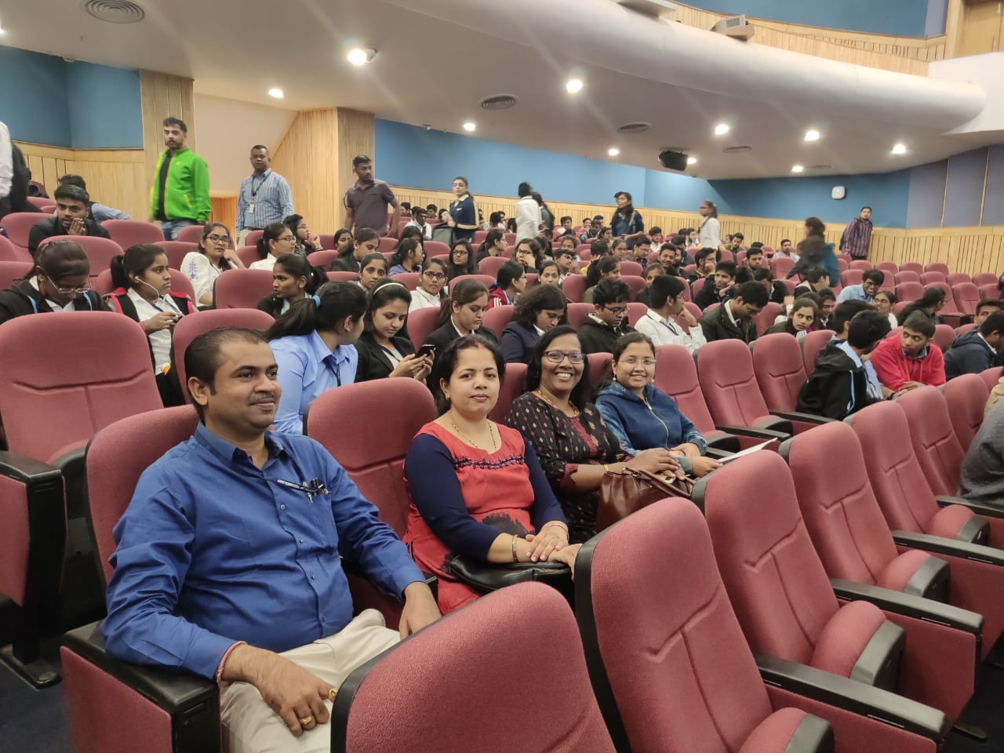
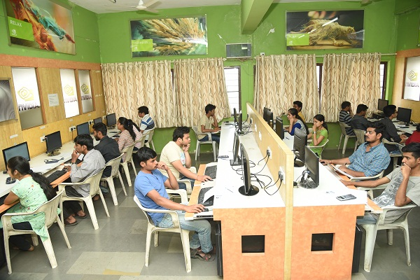
Industry Contribution for Teaching Learning
IAB Meeting
Presented Curriculum
Suggestions Incorporated
Help in Placement and Higher Studies
Curriculum Revision
Lab Development
nVIDIA Lab
GPU Computing based projects
IIT Nodal Center
Research Grants
Industry/ Academia Training
Project Evaluations
Internships
Industry Visits
Courses by industry experts
Sponsored projects
Industrial Visit to Persistent
Sponsored Lab: nVIDIA

Slide 21


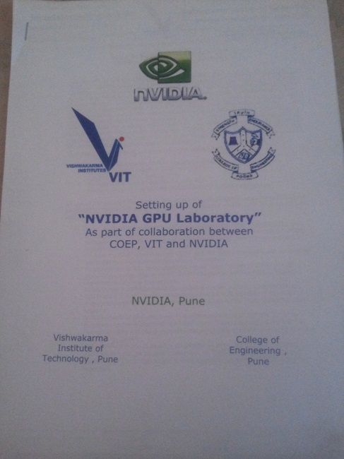
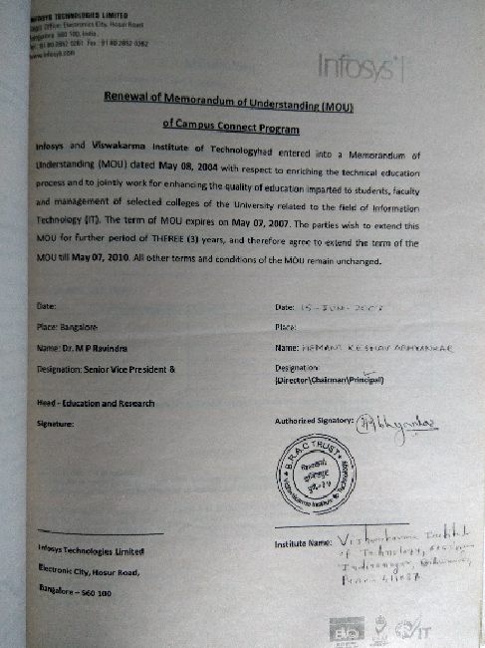
Industy MOUs

Slide 22






Initiatives related to Industry Internship
Provision for semester/year long internship and summer internship
Academic Calendar
Liaisons with Industries
Opportunity for Internships
Six months / year long internships
Liaisons
Twice a semester
Mentor Feedback
Evaluation
Improvement in Placements
Project Commercialization
Paper Publication
Stipends up to Rs. 75000/-
Impact
Companies approached : NVIDIA, Avaya, TOMTOM, IBM, Siemens, eQ Technologic, etc

Slide 23
Course Outcomes & Program Outcomes
23

Slide 24
Relating COs-POs-PSOs-PEOs-MISSION-VISION
Institute Vision
Institute Mission
Department Vision
Department Mission
Program Educational Objectives( PEOs)
Program Outcomes(POs)
Program Specific Outcomes (PSO)
Preparation of Curriculum in-line Blooms Taxonomy
and CO-PO-PSO Mapping
Construction of Program Articulation Matrix and Course Articulation Matrix
.
Every Year Decide Threshold Values for CO Attainment Levels and PO-PSO Attainment Levels
Curriculum Execution suing Direct and Indirect Assessment Tools
After Each Academic Year
Check for Attainment and suggest strategies for Improvement

Slide 25
CO Assessment Process
POs(12)
NBA defined 12 Program Outcomes as mentioned in Annexure I
PSOs(4)
Board of Studies in Computer Engineering defined 04 Program Specific Outcomes
Correlation CO-PO-PSO
Mapping/correlation of courses with all POs and PSOs have been defined using guidelines of NBA in terms of numbers
1: Slight (Low) 2: Moderate (Medium) 3: Substantial (High)
COs
Number of Outcomes for a Course are taken 6
Course Outcomes statements - describe what a students can do after the successful completion of a course. The CO statements are defined by considering the course content. The keywords used to define COs are based on Bloom’s Taxonomy.

Slide 26
CO Assessment Process
Program Outcomes (12)
P01: Engineering knowledge P02: Problem analysis
P03: Design/development of solutions P04:Conduct investigations of complex problems
P05: Modern tool usage P06: The engineer and society.
P07: Environment and sustainability P08: Ethics
P09: Individual and team work P10: Communication
P11: Project management and finance P12: Life-long learning
Program Specific Outcomes (04)
PSO1: Select and incorporate appropriate computing theory principles, data structures and algorithms, programming paradigms to innovatively craft scientific solution addressing complex computing problems.
PSO2: Adapt to new frontiers of science, engineering and technology by getting acquainted with heterogeneous computing environments and platforms, computing hardware architectures and organizations through continuous experimentation.
PSO3: Conceive well-formed design specifications and constructs assimilating new design ideas and facts for identified real world problems using relevant development methodologies and practices, architecture styles and design patterns, modeling and simulation, and CASE tools.
PSO4: Exercise research and development aptitude focusing knowledge creation and dissemination through engineering artifacts construction, preparation and presentation of engineering evidences using procedures, techniques, guidelines, and standards considering technology migration and evolution.

Slide 27
CO Assessment Process
CO Attainment Levels Mapping in Syllabus : One Sample Subject
CS3201::COMPUTER NETWORK TECHNOLOGY Course Prerequisites: Data Communications
Learning Objectives:
1. To understand packet switching architectures of networking reference models.
2. To learn communication framework working for TCP and UDP protocols.
3. To analyze the working of application layer protocols.
4. To learn front end, client side, server side and back end technologies.
5. To develop three tier websites using client side, server side and back end technologies
Credits: 5 Theory: 3 Hr/Week, Tut: 1 Hours/Week Lab: 2 Hours/Week
Course Relevance:. Computer Networks and web technologies are the backbone of all IT infrastructures and their applications in the world.
Course Outcomes: CO attainment levels: 1,2,3,4,5 [ Level 5-Challenging … 1 – Easy ]
1. Analyze data flow between peer to peer in an IP network using Application, Transport and Network Layer Protocols [1]
2. Demonstrate sustainable engineering practice indicating the scientific purpose and utility of communication frameworks and standards [5]
3. Develop Client-Server architectures and prototypes by the means of correct standards, protocols and technologies [3]
4. Comphrehend future web technology architectures for TCP/IP service networks [4]
5. Design of small case websites using front end, server side and backend technologies [2]
6. Development of enterprise websites web sites using client side frameworks, server side and backend technologies [4]

Slide 28
CO Assessment Process
CO-Assessment Map: Course CS3201 Computer Network Technology
COs/Assessment Type-Evaluated Marks | Mid Sem Exam(30) | Seminar (100) | Group Discussion (100) | Lab(100) | Course Project (100) | Home Assignments (100) | CVV (100) | End Sem Exam (30)
CO1: Analyze data flow between peer to peer in an IP network using Application, Transport and Network Layer Protocols | 10 | 18 | 18 | 18 | 18 | 18 | 18 | -
CO2: Demonstrate sustainable engineering practice indicating the scientific purpose and utility of communication frameworks and standards. | 10 | 16 | 16 | 16 | 16 | 16 | 16 | -
CO3: Develop Client-Server architectures and prototypes by the means of correct standards, protocols and technologies. | 10 | 16 | 16 | 16 | 16 | 16 | 16 | -
CO4:Comphrehend future web technology architectures for TCP/IP service networks. | - | 18 | 18 | 18 | 18 | 18 | 18 | 10
CO5:Design of small case websites using front end, server side and backend technologies | - | 16 | 16 | 16 | 16 | 16 | 16 | 10
CO6:Development of enterprise websites web sites using client side frameworks, server side and backend technologies. | - | 16 | 16 | 16 | 16 | 16 | 16 | 10

Slide 29
CO Assessment Process
CO-PO –PSO Assignment Mapping
Mapping/correlation of courses with all POs and PSOs have been defined as
1: Slight (Low) 2: Moderate (Medium) 3: Substantial (High)
PO→ | CORE POs |  |  |  |  | SUPPORTING POs |  |  |  |  |  |  | PROGRAM SPECIFIC OUTCOMES
 | GA1 | GA2 | GA3 | GA4 | GA5 | GA6 | GA7 | GA8 | GA9 | GA10 | GA11 | GA12
YEAR /PO | PO1 | PO2 | PO3 | PO4 | PO5 | PO6 | PO7 | PO8 | PO9 | PO 10 | PO 11 | PO 12 | PSO1 | PSO2 | PSO3 | PSO4
S.Y. | SELECT 4 POS 3 X 3 1X2 |  |  |  |  | SELECT 1 OR 2 PO 1 X 2 |  |  |  |  |  |  | SELECT 1 OR 2 PSO 2 X 3
T.Y. | SELECT 3 POS 2 X 3 1X2 |  |  |  |  | SELECT 2 PO 1 X 3 1 X 2 |  |  |  |  |  |  | SELECT 1 OR 2 PSO 2 X 3
B.TECH. | SELECT 2 POS 2 X 3 |  |  |  |  | SELECT 3 POS 2 X 3 1 X 2 or 1 X 1 |  |  |  |  |  |  |  |  | SELECT 1 OR 2 PSO 2 X 3

Slide 30
CO Assessment Process
Program Articulation Matrix [ 1: Low 2: Medium 3: High ]
Third Year AY 2020-21 |  | PO1 | PO2 | PO3 | PO4 | PO5 | PO6 | PO7 | PO8 | PO9 | PO10 | PO11 | PO12 | PSO1 | PSO2 | PSO3 | PSO4
CS3201 | Computer Network Technology | 0 | 2 | 3 | 3 | 3 | 2 | 0 | 2 | 1 | 0 | 1 | 1 | 0 | 3 | 0 | 3
CS3202 | Artificial Intelligence | 0 | 2 | 0 | 3 | 3 | 2 | 0 | 0 | 0 | 1 | 0 | 0 | 3 | 0 | 0 | 0
CS3203 | System Software | 0 | 2 | 3 | 3 | 0 | 0 | 0 | 0 | 0 | 2 | 0 | 1 | 0 | 0 | 3 | 0
CS3204 | Automated Software Engineering | 0 | 2 | 3 | 3 | 0 | 0 | 0 | 2 | 0 | 0 | 1 | 0 | 3 | 0 | 0 | 0
CS3205 | Design and Analysis of Algorithms | 3 | 2 | 3 | 3 | 0 | 2 | 0 | 0 | 0 | 0 | 0 | 2 | 3 | 0 | 0 | 0
CS3206 | Data Science | 2 | 0 | 3 | 3 | 0 | 0 | 2 | 0 | 0 | 0 | 1 | 0 | 0 | 0 | 3 | 0
CS3207 | Compiler Design | 0 | 2 | 3 | 3 | 0 | 0 | 0 | 0 | 0 | 0 | 3 | 1 | 0 | 0 | 3 | 0
CS3208 | Cyber Security | 0 | 2 | 3 | 0 | 3 | 2 | 0 | 0 | 1 | 0 | 0 | 0 | 0 | 0 | 3 | 0
CS3209 | Engineering Design and Innovation-III | 3 | 3 | 2 | 3 | 3 | 2 | 2 | 2 | 2 | 0 | 1 | 2 | 0 | 3 | 2 | 2
CS3210 | Engineering Design and Innovation-IV | 3 | 3 | 2 | 2 | 2 | 2 | 2 | 2 | 2 | 0 | 1 | 2 | 0 | 3 | 2 | 2

Slide 31
CO Assessment Process
Course Articulation Matrix [CO-PO Map]
Course | CS3201:Computer Network Technology | PO1 | PO2 | PO3 | PO4 | PO5 | PO6 | PO7 | PO8 | PO9 | PO10 | PO11 | PO12 | PSO1 | PS02 | PSO3 | PSO4
CO | Statement
CS3201.1 | Analyze data flow between peer to peer in an IP network using Application, Transport and Network Layer Protocols | - | 2 | - | - | 3 | - | - | - | - | - | - | - | - | - | - | -
CS3201.2 | Demonstrate sustainable engineering practice indicating the scientific purpose and utility of communication frameworks and standards. | - | - | 3 | - | - | - | - | - | - | - | - | - | - | - | - | -
CS3201.3 | Develop Client-Server architectures and prototypes by the means of correct standards, protocols and technologies. | - | - | - | 3 | - | - | - | 2 | - | - | - | - | - | - | - | -
CS3201.4 | Comphrehend future web technology architectures for TCP/IP service networks. | - | - | - | - | - | 2 | - | - | - | - | - | - | - | - | - | -
CS3201.5 | Design of small case websites using front end, server side and backend technologies | - | - | - | - | - | - | - | - | 1 | - | 1 | 1 | - | - | - | -
CS3201.6 | Development of enterprise websites web sites using client side frameworks, server side and backend technologies. | - | - | - | - | - | - | - | - | - | - | - | - | - | 3 | - | 3

Slide 32
CO Assessment Process
CO-PO-PSO Mapping Justification
CO Statement | PO | Map | Justification
CO01: Analyze data flow between peer to peer in an IP network using Application, Transport and Network Layer Protocols | PO2 | 2 | Mapped moderately as all students acquire ability to do carry protocol analysis
 | PO5 | 3 | Mapped strongly as all student gain hands-on using modern tools
CO02: Demonstrate sustainable engineering practice indicating the scientific purpose and utility of communication frameworks and standards | PO3 | 3 | Mapped strongly as all students acquire capacity to use fundamental IEEE standards to design scalable communication frameworks
CO03: Develop Client-Server architectures and prototypes by the means of correct standards, protocols and technologies. | PO4 | 3 | Mapped strongly as all students acquire ability to use standards, protocols and technologies together
 | PO8 | 2 | Mapped moderately as all students know the importance of following ethics on field
CO04: Comprehend future web technology architectures for TCP/IP service networks | PO6 | 2 | Mapped moderately as all students understand impact of future technologies in real implementation
CO05: Design of small case websites using front end, server side and backend technologies | PO9 | 1 | Mapped as all students understand working as individual as well as in a group as team
 | PO11 | 1 | Mapped as all students understand about the project management by developing small scale client-servers
 | PO12 | 1 | Mapped as all students to create learning ability by starting development with small scale assignments
CO06: Development of enterprise websites web sites using client side frameworks, server side and backend technologies. | PS02 | 3 | Mapped strongly as all students adapt engineering and technology with heterogeneous computing
 | PSO4 | 3 | Mapped strongly as all students understand implementation and dissemination considering technology migration and evolution.

Slide 33
Course Outcome Assessment
Assessment Tools for Course Outcomes (Direct)
Assessment Tools | In semester Assessment (50%) Core Courses 4 & 5 Credits |  |  |  | End semester Assessment (50%) Core Courses 4 & 5 Credits
Assessment Details | Mid Sem Exam | Seminar | Group Discussion | Lab | Course Project | HA | CVV | End Sem Exam | Total
Evaluated Marks | 30 | 100 | 100 | 100 | 100 | 100 | 100 | 30 | 660
Converted Mark % | 10% | 15% | 15% | 10% | 10% | 10% | 20% | 10% | 100%
Project Based /Centric Courses | Assessment Tools | In-Semester Assessment | End Semester Assessment | Total
Software Development Project Engineering Design and Innovation Major Project Internship | Evaluated Marks | 50 | 100 | 150
 | Converted Mark % | 30% | 70% | 100%

Slide 34
CO Assessment Process
CO Attainment Level and Marks Computation
COs for all courses have been assigned different attainment levels between 1 and 5
The 5 being the most challenging CO to attain while 1 is easy
The 60% threshold level is set for scores of the students in the examination
n - number of students scoring more marks than the set threshold score (60 %)
N - number of students appearing for the examination of particular course
Ratio (n/N) is calculated
The ratio required to attain the COs with different attainment levels is given in table
Attainment level | 1 | 2 | 3 | 4 | 5
Required value of the ratio (n/N) | 0.75 | 0.70 | 0.65 | 0.60 | 0.55
COs for Course CS3201 | CO1 | CO2 | CO3 | CO4 | CO5 | CO6
Attainment level | 1 | 5 | 3 | 4 | 2 | 4
POs | PO2 | PO3 | PO4,PO8 | PO6 | PO9,PO11PO12 | PSO2, PSO4
Correlation | 2 | 3 | 3, 2 | 2 | 1, 1, 1 | 3, 3

Slide 35
CO Assessment Process
Map of CO for In Semester and End Semester Theory Assessment
CS3201 | In semester Assessment (30 Marks) |  |  | End semester Assessment (30 Marks)
Question No. | CO1 (Max Marks:10.5) | CO2 (Max Marks:10.5) | CO3 (Max Marks:09) | CO4 (Max Marks:10.5) | CO5 (Max Marks:10.5) | CO6 (Max Marks:09)
Q.1-Q.7 | 10.5 | - | - | - | - | -
Q.8-Q.14 | - | 10.5 | - | - | - | -
Q.15-Q.20 | - | - | 09 | - | - | -
Q.1-Q.7 | - | - | - | 10.5 | - | -
Q.8-Q.14 | - | - | - | - | 10.5 | -
Q.15-Q.20 | - | - | - | - | - | 09
Total | 10.5 | 10.5 | 09 | 10.5 | 10.5 | 09
CO wise marks obtained by students in MSE and ESE
GR No | MSE + ESE Theory Marks 60 | CO Wise Evaluated Marks
 |  | CO1 (10.5) | CO2 (10.5) | CO3 (09) | CO4 (10.5) | CO5 (10.5) | CO6 (09)
11XXXX18 | 45 | 9 | 4.5 | 6 | 6 | 10.5 | 9
11XXXX76 | 33 | 3 | 3 | 1.5 | 9 | 9 | 7.5
11XXXX07 | 45 | 9 | 4.5 | 4.5 | 9 | 9 | 9
11XXXX56 | 46.5 | 9 | 4.5 | 4.5 | 9 | 10.5 | 9

Slide 36
CO Attainment
CO Attainment for Course CS3201: Computer Network Technology AY2020-21
Sr. No. | Student GR No | CO Wise percentage marks scored
 |  | CO1 | CO2 | CO3 | CO4 | CO5 | CO6
1 | 11XXXX18 | 85.71 | 42.85 | 66.66 | 57.14 | 100 | 100
2 | 11XXXX76 | 28.57 | 28.57 | 16.66 | 85.71 | 85.71 | 83.33
3 | 11XXXX07 | 85.71 | 42.85 | 50 | 85.71 | 85.71 | 100
4 | 11XXXX56 | 85.71 | 42.85 | 50 | 85.71 | 100 | 100
- | - | - | - | - | - | - | -
. | - | - | - | - | - | - | -
. | - | - | - | - | - | - | -
N | - | - | - | - | - | - | -
CO attainment level. |  | 1 | 5 | 3 | 4 | 2 | 4
Number of students scoring more than 60% (n) |  | 116 | 48 | 48 | 118 | 149 | 142
Total number of students (N) |  | 148 | 148 | 148 | 149 | 149 | 149
Ratio (n/N) |  | 0.78 | 0.32 | 0.32 | 0.79 | 100 | 0.95
Threshold Value |  | 60% | 60% | 60% | 60% | 60% | 60%
Attained ((Yes/No) |  | Yes | No | No | Yes | Yes | Yes

Slide 37
Improvement Through CO Non-Attainment
Attainment in Sem 1 of Academic Year 2018-19
Corrective Actions Taken in the areas of :
Pedagogy/ Teaching Methodology (Reflected in Course Plan)
Assessment Tools (Reflected in Question asked in HAs, CTs and ESEs)
Course Topics (Will be reflected in revised curriculum in Academic year 2019-20)
Contact Hours (Will be reflected in revised structure in Academic year 2019-20)
Prerequisite / Bridge Courses (Will be reflected in revised structure in Academic year 2019-20)
Corrective Action taken in Sem 2 of Academic Year 2018-19
CO Attained?
No
Yes
Attainment in Sem 2 of Academic Year 2018-19
Corrective Action taken in Sem 1 of Academic Year 2019-20
CO Attained?
No
Yes
Level may increased after
another year of assessment
if the trend persist
………..

Slide 38
Academic Audit Feedback and Corrective Actions
Syllabus and
Course Content
Auditor’s Comment : Have suggested changes in some courses. For eg in TOC course we need to have some programming assignments based on HMM and transliteration to drive home points related to Automata theory.
Course Delivery
Assessment
Auditor’s Comment: Descriptive questions should be kept as minimal as possible and numerical or problems should be asked by providing more applied/ real life examples.
These comments have been considered while setting question papers in AY 2019-20
Auditor’s Comment: It is extremely necessary to have good, detailed motivational examples in the beginning.
Action planned: Course Plan now reflects more practical Examples to sufficiently motivate the students
The next curriculum revision from AY 2020-21 shall address these comments.

Slide 39
PO Evaluation Process
Assessment Tools and Assessment Parameters for PO Attainment
Direct attainment:- Through CO-PO mapping and attainment of COs. (Students Performance In semester and End Semester Examinations)
Based on the attainment of the COs, the attainment of POs and PSOs is determined.
PO-PSO(n) - sum of weights (correlation level) of the affected (non-attained) COs (n)
PO-PSO(N) - sum of weights of all COs influencing a particular PO or PSO (N).
The attainment for all POs and PSOs is calculated as: % Attainment = [(N-n)/N]*100
The attainment threshold for all POs and PSOs is set as 75% for AY 2020-21
In-Direct attainment:- Through surveys (Alumni, Employer, Students Exit survey). (Using Questionnaires). Simple statements addressing the purpose of POs and PSOs were prepared and they were asked to express their opinion on a scale of 0 to 10.
Overall PO attainment= 0.8 (Direct attainment)+ 0.2 (In-Direct attainment)

Slide 40
PO Evaluation Process
Assessment Tools and Assessment Parameters for PO Attainment
Assessment Tools | Direct Assessment (80%) | In-Semester Assessment (50%) | Mid Semester Exam Laboratory Seminar Group Discussion | 10% Weightage 10% Weightage 15% Weightage 15% Weightage
 |  | End Semester Assessment (50%) | End Semester Exam(Theory) Course Project Home Assignment Comprehensive Viva Voce | 10% Weightage 10% Weightage 10% Weightage 20% Weightage
 | Indirect Assessment (20%) | End of each Year | Students Exit feedback Alumni Feedback Employer feedback | Simple statements addressing the purpose of POs and PSOs were prepared, and they were asked to express their opinion on a scale of 0 to 10.

Slide 41
PO-PSO Attainment Process
PO-PSO Direct Attainment Table For One Course
Sample Single Course Computer Networks | PO1 | PO2 | PO3 | PO4 | PO5 | PO6 | PO7 | PO8 | PO9 | PO10 | PO11 | PO12 | PSO 1 | PS0 2 | PSO3 | PSO4
CO1 | - | 2 | - | - | 3 | - | - | 3 | - | - | - | - | - | - | - | -
CO2 | - | - | 3 | 2 | - | - | - | - | - | - | - | - | - | - | - | -
CO3(affected) | - | - | - | 3 | - | - | - | 2 | - | - | - | - | - | - | - | -
CO4(affected) | - | - | - | - | - | 2 | - | - | - | - | - | - | - | - | - | -
CO5 | - | - | - | - | - | 3 | - | 2 | 1 | - | 1 | 1 | - | - | - | -
CO6 | - | - | - | - | - | - | - | - | - | - | - | - | - | 3 | - | 3
N | 0 | 2 | 3 | 5 | 3 | 5 | 0 | 8 | 1 | 0 | 1 | 1 | 0 | 3 | 0 | 3
n | 0 | 0 | 0 | 3 | 0 | 2 | 0 | 2 | 0 | 0 | 0 | 0 | 0 | 0 | 0 | 0
% Direct Attainment [(N-n)/N]*3 | NA | 2 | 3 | 1.2 | 3 | 1.8 | NA | 2.25 | 1 | NA | 1 | 1 | NA | 3 | 0 | 3
% Direct Attainment [(N-n)/N]*100 | NA | 100 | 100 | 40 | 100 | 60 | NA | 75 | 100 | NA | 100 | 100 | NA | 100 | NA | 100
Direct Attainment (Yes/No) | NA | Yes | Yes | No | Yes | No | NA | Yes | Yes | NA | Yes | Yes | NA | Yes | NA | Yes

Slide 42
PO-PSO - Direct Attainment AY2020-21
For all courses from Second Year To Fourth Year
Course | PO1 | PO2 | PO3 | PO4 | PO5 | PO6 | PO7 | PO8 | PO9 | PO10 | PO11 | PO12 | PSO1 | PSO2 | PSO3 | PSO4
MD2201:1 | 2 | 2 | 1 | 0 | 0 | 2 | 0 | 0 | 0 | 0 | 0 | 0 | 0 | 0 | 0 | 0
MD2202:1 | 3 | 0 | 0 | 0 | 0 | 0 | 0 | 0 | 0 | 0 | 0 | 0 | 0 | 0 | 0 | 0
CS2207.6 | 0 | 0 | 0 | 0 | 0 | 0 | 0 | 0 | 0 | 0 | 0 | 2 | 3 | 3 | 0 | 0
CS2208.1 | 3 | 0 | 3 | 0 | 0 | 0 | 0 | 0 | 0 | 0 | 0 | 0 | 0 | 0 | 0 | 0
CS3201.1 | 0 | 2 | 0 | 0 | 3 | 0 | 0 | 0 | 0 | 0 | 0 | 0 | 0 | 0 | 0 | 0
CS3209:1 | 3 | 0 | 0 | 0 | 0 | 0 | 0 | 0 | 0 | 0 | 0 | 0 | 0 | 0 | 0 | 0
CS3210:5 | 0 | 0 | 0 | 0 | 0 | 2 | 2 | 0 | 2 | 0 | 1 | 0 | 0 | 0 | 0 | 0
MD4203:1 | 3 | 0 | 0 | 0 | 0 | 0 | 0 | 1 | 0 | 0 | 0 | 0 | 0 | 0 | 0 | 0
CS4225:2 | 0 | 0 | 0 | 3 | 3 | 0 | 0 | 0 | 0 | 0 | 0 | 2 | 0 | 0 | 0 | 0
CS4232:3 | 0 | 0 | 0 | 0 | 0 | 2 | 0 | 0 | 0 | 0 | 0 | 0 | 0 | 0 | 0 | 0
CS4232:5 | 0 | 0 | 0 | 0 | 0 | 0 | 0 | 0 | 0 | 0 | 1 | 0 | 0 | 0 | 0 | 0
CS4232:6 | 0 | 0 | 0 | 0 | 0 | 0 | 0 | 0 | 0 | 0 | 0 | 0 | 0 | 0 | 3 | 3
CS4233:1 | 0 | 0 | 3 | 0 | 0 | 0 | 0 | 0 | 0 | 0 | 0 | 0 | 0 | 0 | 0 | 0
CS4233:5 | 0 | 0 | 0 | 0 | 0 | 0 | 0 | 0 | 0 | 0 | 1 | 0 | 0 | 0 | 0 | 0
CS4233:6 | 0 | 0 | 0 | 0 | 0 | 0 | 0 | 0 | 0 | 0 | 0 | 0 | 0 | 0 | 3 | 3
Total (N) | 77 | 88 | 96 | 82 | 75 | 40 | 28 | 39 | 47 | 20 | 35 | 48 | 49 | 40 | 49 | 36
Threshold (75% of N ) | 57.75 | 66 | 72 | 61.5 | 56.25 | 30 | 21 | 29.25 | 35.25 | 15 | 26.25 | 36 | 36.75 | 30 | 36.75 | 27
Affected (n) | 0 | 0 | 4 | 0 | 4 | 4 | 4 | 4 | 6 | 0 | 1 | 3 | 3 | 3 | 3 | 3
Not Affected | 77 | 88 | 92 | 82 | 71 | 36 | 24 | 35 | 41 | 20 | 34 | 45 | 46 | 37 | 46 | 33
% Direct PO Attainment | 100 | 100 | 95.83 | 100 | 94.67 | 90 | 85.71 | 89.74 | 87.23 | 100 | 97.14 | 93.75 | 93.88 | 92.5 | 93.87 | 91.67
PO Attained | Yes | Yes | Yes | Yes | Yes | Yes | Yes | Yes | Yes | Yes | Yes | Yes | Yes | Yes | Yes | Yes

Slide 43
PO-PSO- Indirect Attainment AY2020-21
Survey | PO1 | PO2 | PO3 | PO4 | PO5 | PO6 | PO7 | PO8 | PO9 | PO10 | PO11 | PO12 | PSO1 | PSO2 | PSO3 | PSO4
Student Exit Feedback | 8.585 | 8.551 | 7.827 | 8.172 | 7.81 | 7.505 | 5.635 | 6.93 | 5.662 | 8.561 | 8.673 | 7.585 | 9.09 | 8.78 | 8.81 | 9.01
Alumni Feedback | 8.77 | 8.5 | 8.79 | 8.96 | 8.82 | 8.73 | 8.70 | 9.04 | 9.43 | 9.21 | 8.98 | 9.26 | 9.09 | 8.78 | 8.81 | 9.01
Employer Feedback | 8.76 | 8.69 | 8.46 | 8.54 | 9.08 | 8.85 | 8.77 | 9.0 | 9.08 | 8.77 | 8.38 | 9.0 | 8.92 | 8.85 | 8.69 | 8.85
Average Score | 8.705 | 8.58 | 8.359 | 8.557 | 8.57 | 8.362 | 7.702 | 8.323 | 8.057 | 8.847 | 8.678 | 8.615 | 9.033 | 8.803 | 8.77 | 8.957
% Indirect Attainment | 87.05 | 85.8 | 83.59 | 85.57 | 85.7 | 83.62 | 77.02 | 83.23 | 80.57 | 88.47 | 86.78 | 86.15 | 90.33 | 88.03 | 87.7 | 89.57
Indirect Attainment | Yes | Yes | Yes | Yes | Yes | Yes | Yes | Yes | Yes | Yes | Yes | Yes | Yes | Yes | Yes | Yes

Slide 44
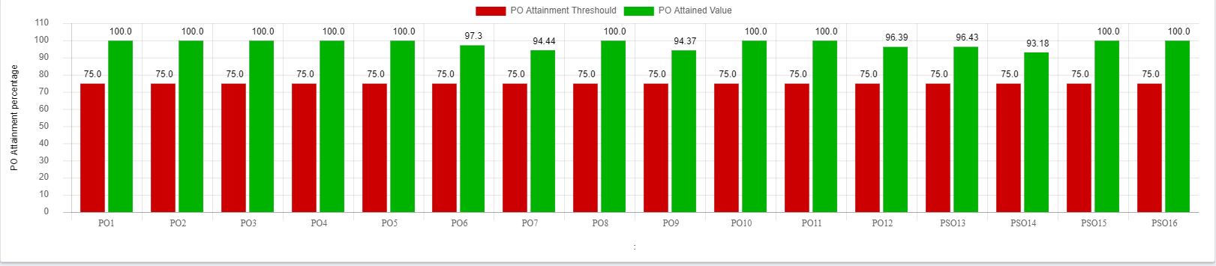
Final PO-PSO Attainment AY2020-21
PO/PSO | PO 1 | PO 2 | PO 3 | PO 4 | PO 5 | PO 6 | PO 7 | PO 8 | PO 9 | PO 10 | PO 11 | PO 12 | PSO1 | PSO2 | PSO3 | PSO4
0.8* Direct attainment | 80 | 80 | 76.66 | 80 | 75.74 | 72 | 68.57 | 71.79 | 69.78 | 80 | 77.71 | 75 | 75.1 | 74 | 75.08 | 73.34
0.2* Indirect attainment | 17.41 | 17.16 | 16.72 | 17.11 | 17.14 | 16.72 | 15.4 | 16.65 | 16.11 | 17.69 | 17.36 | 17.23 | 18.07 | 17.61 | 17.54 | 17.91
Final % attainment | 97.41 | 97.16 | 93.38 | 97.11 | 92.88 | 88.72 | 83.97 | 88.44 | 85.9 | 97.69 | 95.07 | 92.23 | 93.17 | 91.61 | 92.62 | 91.25
PO/PSO Attained (Yes/No) | Yes | Yes | Yes | Yes | Yes | Yes | Yes | Yes | Yes | Yes | Yes | Yes | Yes | Yes | Yes | Yes

Slide 45
Student Performance

Slide 46
Enrollment Ratio
Year of Entry | CAY (2021-22) | CAYm1 (2020-21) | CAYm2 (2019-20)
Sanctioned intake of the program (N) | 240 | 240 | 240
Total number of students admitted in first year minus number of students migrated to other programs/institutions plus no. of students migrated to this program (N1) | 275 | 291 | 296
Enrollment Ratio % | 114.58 | 121.25 | 123.33
Average % | 119.72

Slide 47
Success Index
Year of Graduate
Year of Graduate
Average SI =0.58
Success Index without Backlog
Average SI =0.93
Success Index with Backlog

Slide 48
Academic Performance Index
Year of Graduate
Average API Second Year = 8.34

Slide 49
Placement, Higher Studies and Entrepreneurship
Placement, Higher Studies and Entrepreneurship
Item | CAYm1 (2020-21) | CAYm2 (2019-20) | CAYm3 (2018-19)
Total No. of Final Year Students (N) | 221 | 188 | 170
No. of Students Placed in Companies or Government Sector (x) | 194 | 149 | 127
No. of students admitted to higher studies with valid qualifying scores (GATE or Equivalent State or national Level Tests, GRE, GMAT etc.) (y) | 15 | 19 | 28
No. of students turned entrepreneur in Engineering /Technology (z) | 3 | 0 | 1
X + Y + Z = | 212 | 168 | 156
Placement Index= ( X + Y + Z ) / N | 0.96 | 0.89 | 0.92
Average Placement = (P1+P2+P3) / 3 | 0.92 | 0.92

Slide 50


Professional Societies
Sr. No. | Professional Student Chapter | No. Of Activities For assessment years
1 | IEEE | 42
2 | Developer student Club | 11
3 | Trident Lab | 02

Slide 51

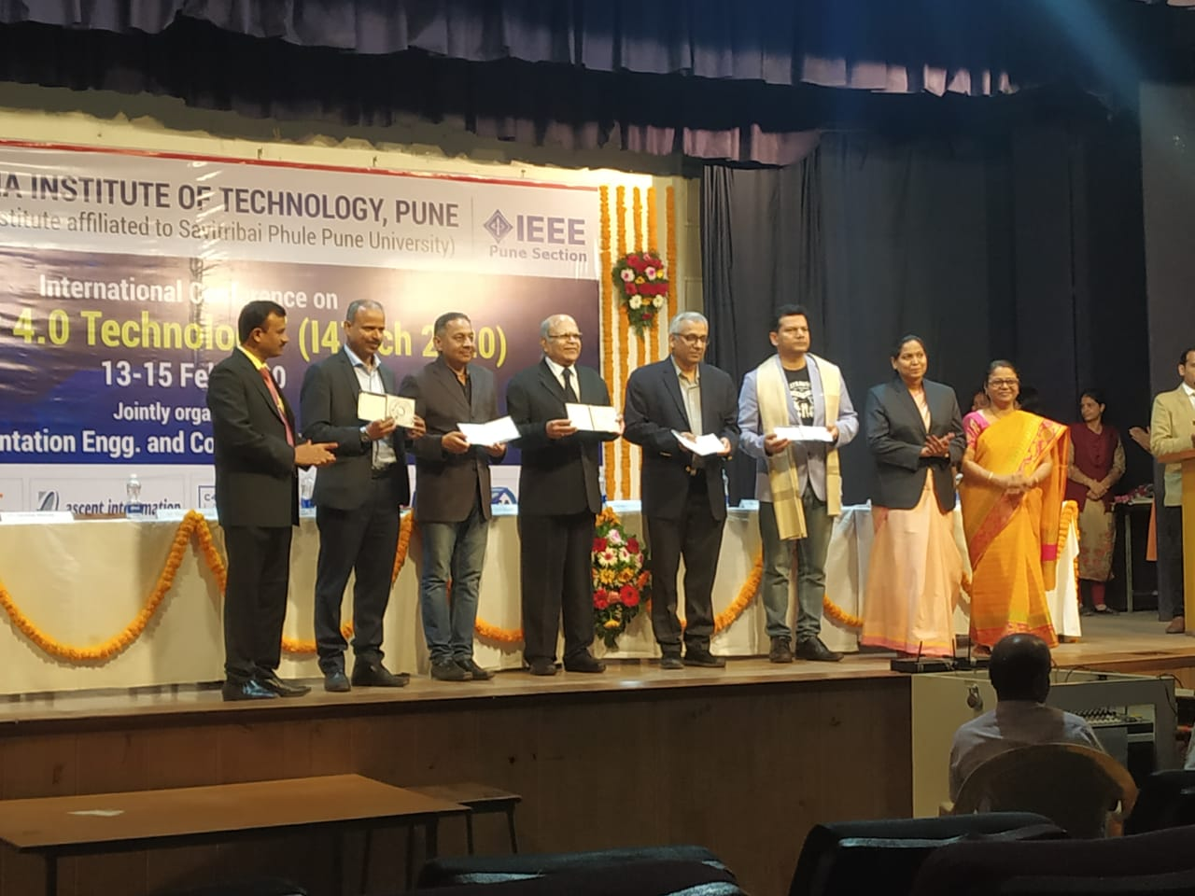

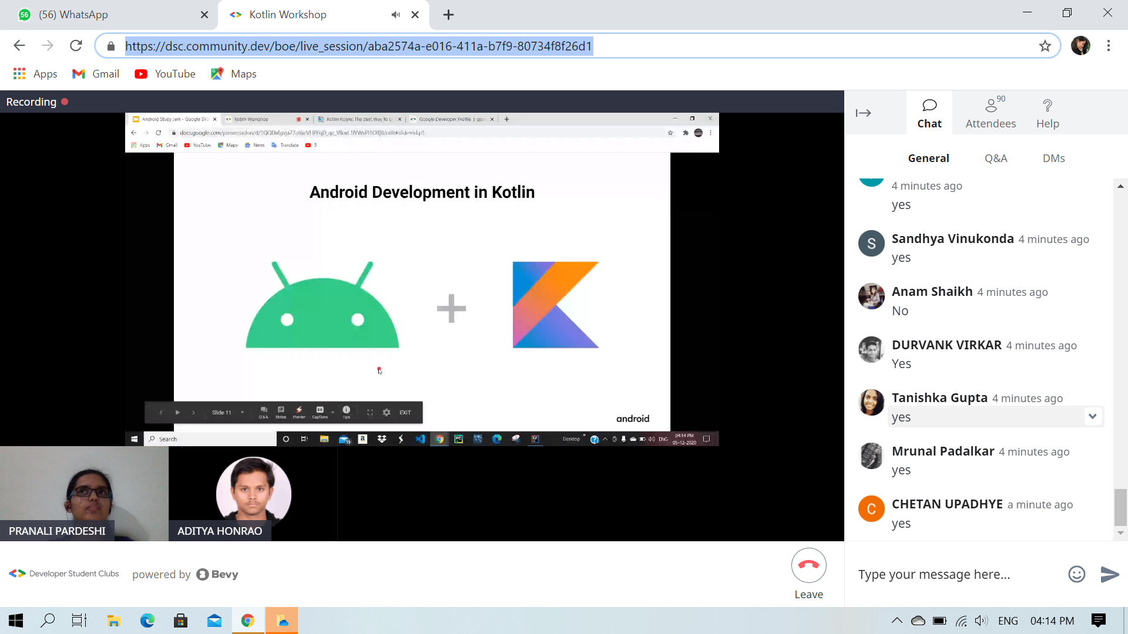
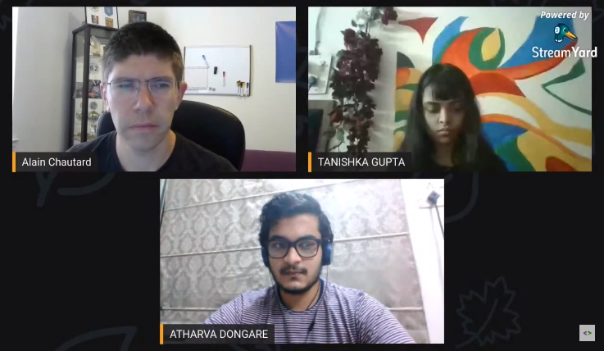
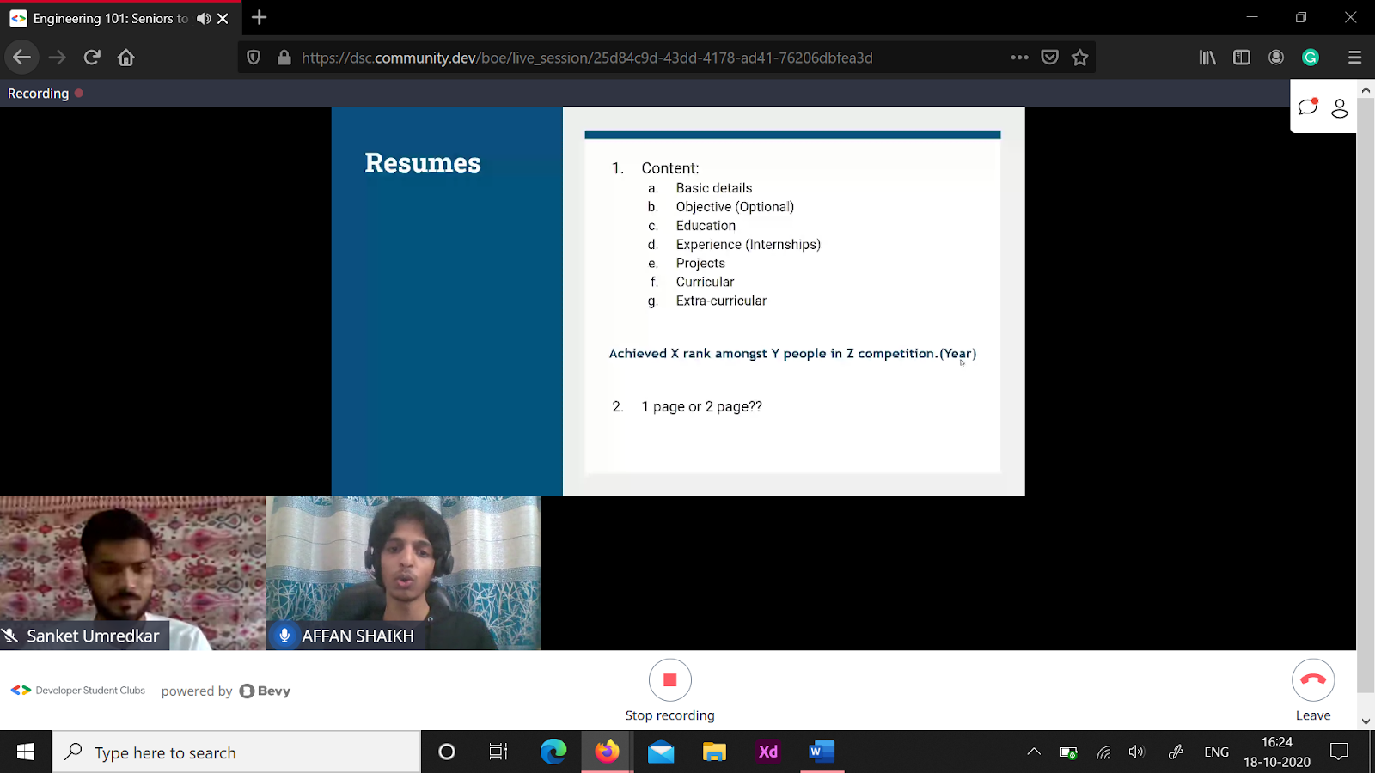
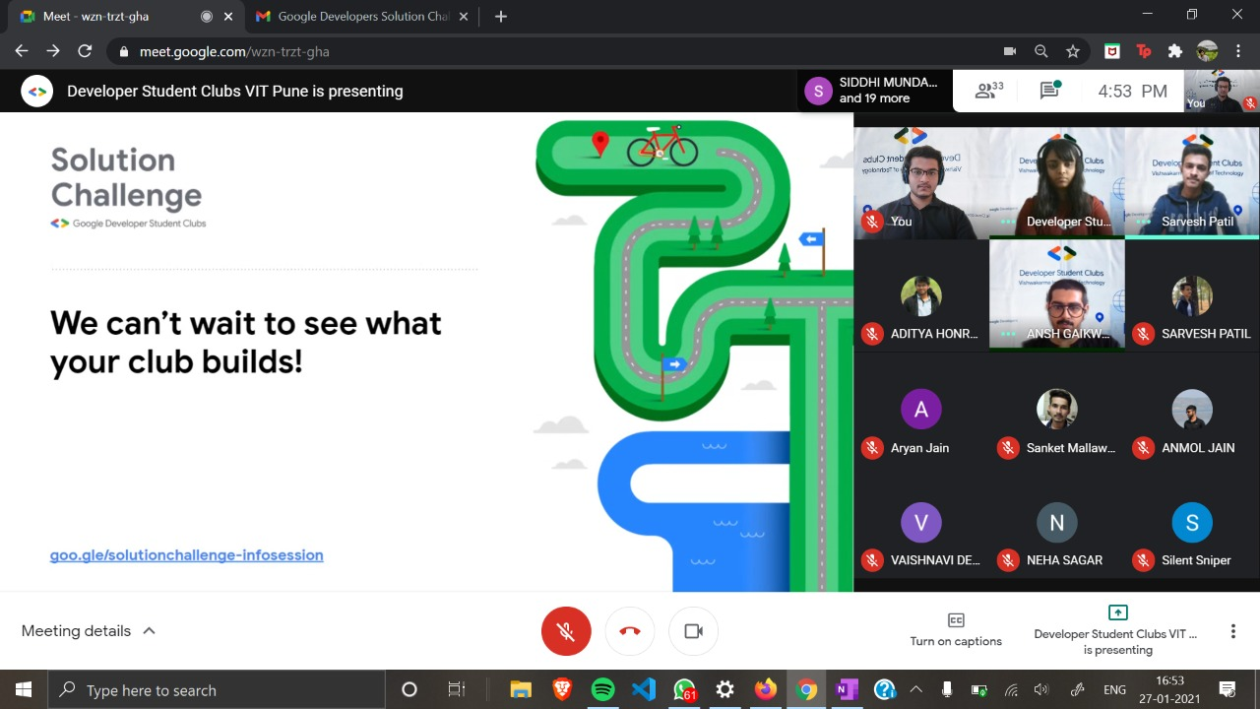
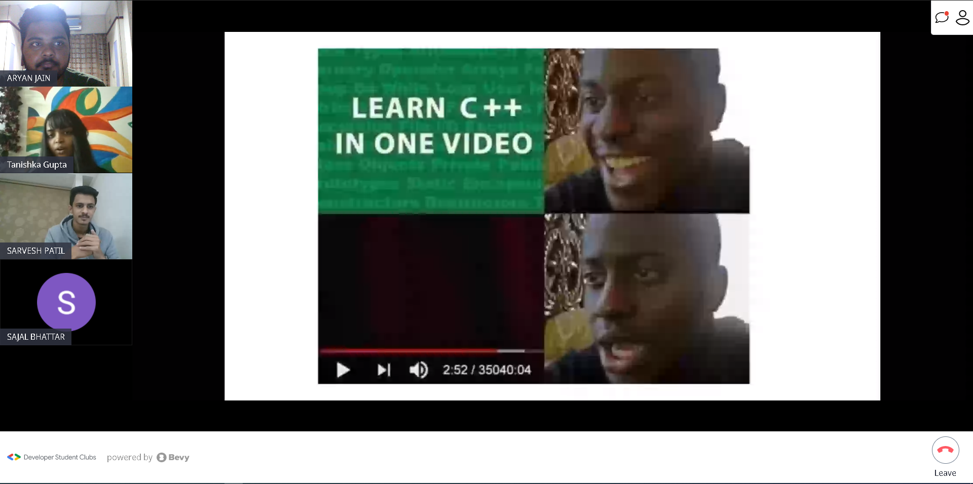
Professional Activities
Space App India Hackathon
International Conference on “ Industry 4.0 “
Game Design Workshop
Android Study Jam 3Workshop
Embark: A series of talkshows
DSC - Seniors to your rescue
2021 Solution Challenge
CPP BootCamp

Slide 52
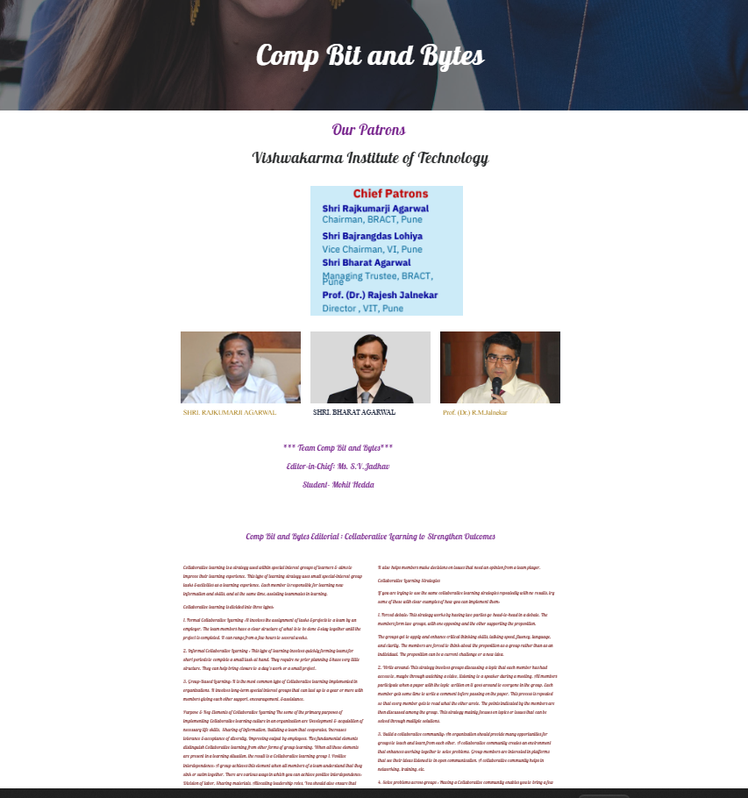
Departmental Newsletter
Departmental Newsletter- Comp Bit and Bytes - 2021-22-2(31 may 2022 ) (google.com)

Slide 53
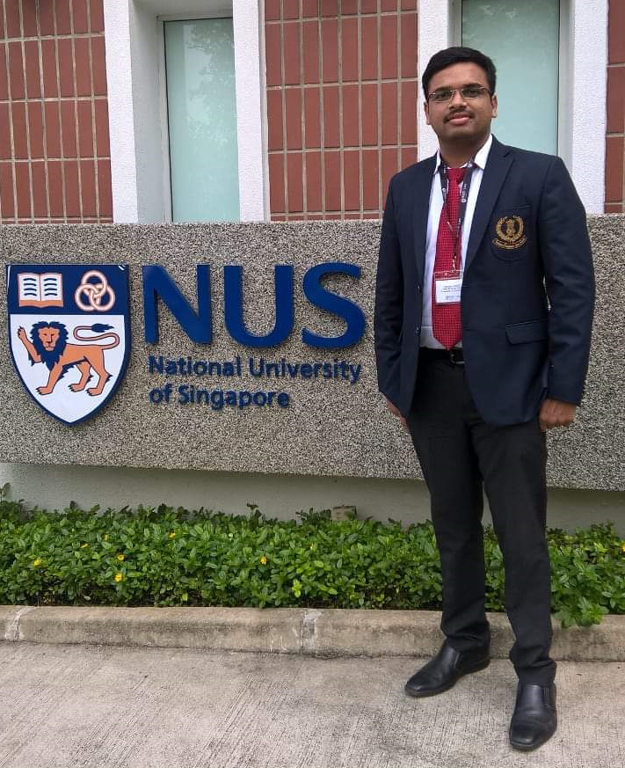
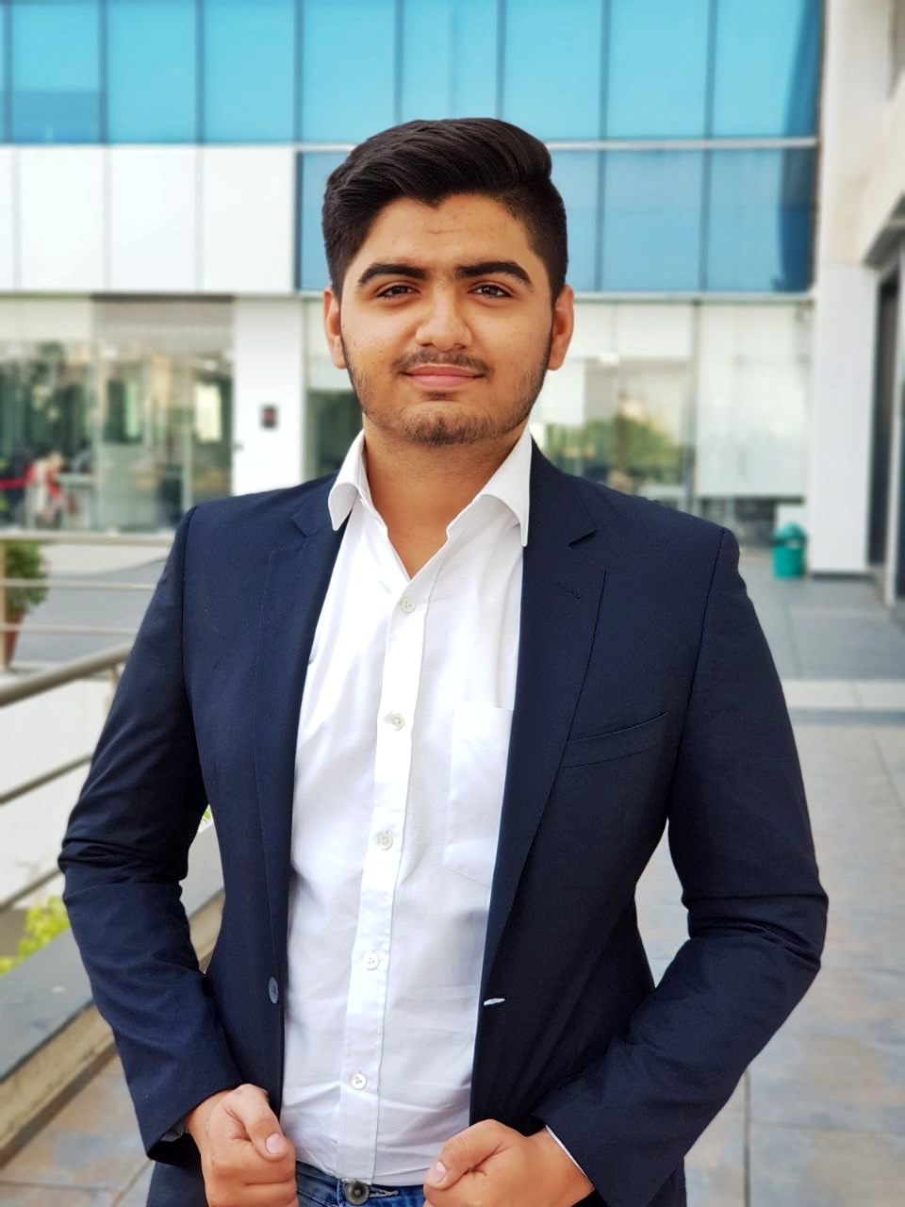
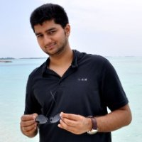
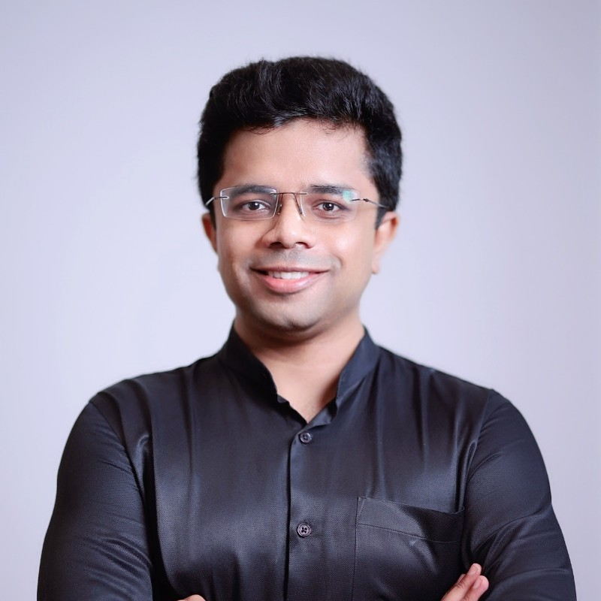

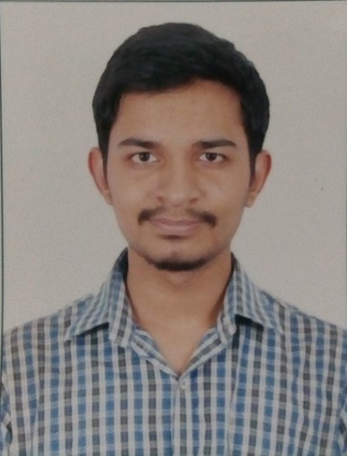
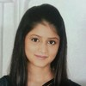
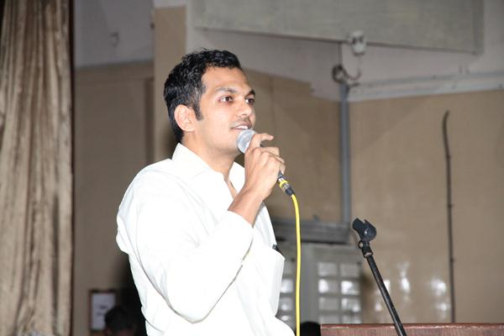
Distinguished Alumni
Vaibhav Kajale (IAS) UPSC Ranker
Karan Parseja Software Engineer at Meta
Viraj Kulkarni
Indrajeet Patil, Founder & CEO at Cereble Robotics
Entrepreneur and Computer Scientist
Rohan R Vibhandik
Anvit Phatak,
Director
Ninad Kavimandan
Software Engineer 2 at Microsoft
Miloni Mehata
Software Engineer at Amazon
Research Scientist - Cyber Intelligence
Millennium National School, Pune

Slide 54
Awards/Achievements in Inter-Institute Events
Academic Year | State Level | National Level | International Level
2021-22 | 5 | 4 | 5
2020-21 | 05 | 15 | 07
2019-20 | 01 | 04 | 01
2018-19 | 04 | 07 | 04
Participation in Inter-Institute Events
Academic Year | State Level | National Level | International Level
2021-22 | 5 | 10 | 17
2020-21 | 7 | 22 | 8
2019-20 | 5 | 8 | 3
2018-19 | 6 | 11 | 4

Slide 55
Faculty Contributions
55

Slide 56
Student Faculty Ratio
Academic Year wise Student Faculty Ratio
Academic Year | No. of Students | Total No. of Staff | Student Faculty Ratio
2021-22 | 832 | 54 | 15.40
2020-21 | 767 | 46 | 16.67
2019-20 | 674 | 43 | 15.67
Average SFR |  |  | 15.91
56

Slide 57
Faculty Cadre Ratio
Academic Year | Professor |  | Associate Professor |  | Assistant Professor
 | Required | Available | Required | Available | Required | Available
CAY (2021-22 ) | 4 | 3 | 8 | 3 | 30 | 48
CAYm1 (2020-21 ) | 4 | 3 | 8 | 2 | 27 | 41
CAYm2 (2019-20 ) | 3 | 2 | 7 | 1 | 24 | 40
Average Numbers | 4 | 3 | 8 | 2 | 27 | 43
Cadre Ratio Marks=[(AF1/RF1)+[(AF2/RF2)*0.6]+[(AF3/RF3)*0.4]]*12.5:
[(0.75) + [(0.25*0.6)] + [(1.59*0.4)]]*12.5 = (as per manual calculation = )19.25
57

Slide 58
Faculty Qualification
Academic Year | Faculty Members |  |  | FQ = 2.5 x [(10X +4Y)/F]
 | X (Ph D) | Y (M Tech) | F(Required)
CAY (2021-22 ) | 12 | 42 | 42 | 17.14
CAYm1 ( 2020-21) | 8 | 38 | 39 | 14.87
CAYm2 (2019-20 ) | 8 | 35 | 34 | 16.18
Average |  |  |  | 16.06
58

Slide 59
Faculty Retention
Description | 2020-21 | 2021-22
No. of Faculty Retained | 24 | 21
Total No. of Faculty | 44 | 44
% of Faculty Retained | 55 | 48
Average |  | 51
59

Slide 60
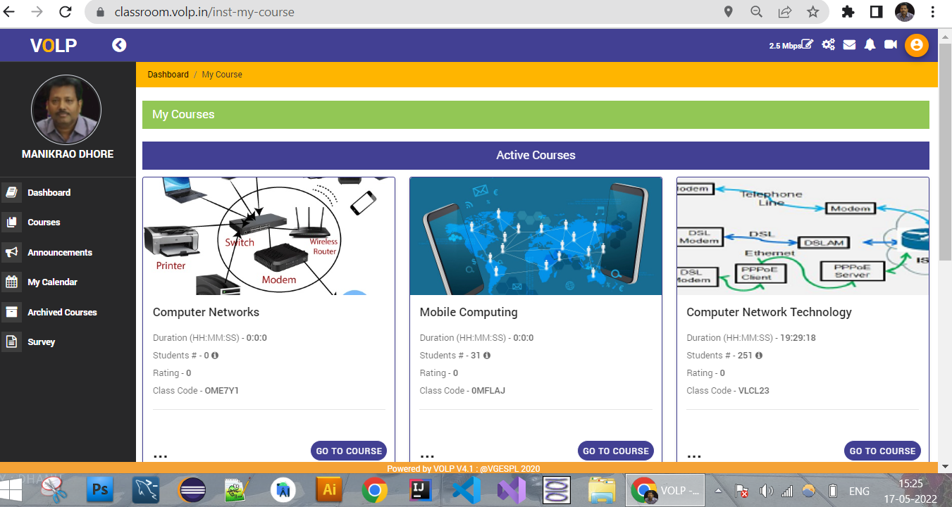
Innovation In teaching -Learning
Name of Faculty | Subject Name | Link / Channel
Ms. S. V. Jadhav | Object Oriented Programming With JAVA | https://youtu.be/GRSes0Vn4Xo
 | Problem Solving and Programming with Python | https://youtu.be/Bi-BmZ4Z-7M
 | System Programming | https://youtu.be/ZKNCr8XiL0Q
Dr. M.L. Dhore | Computer Network | https://www.youtube.com/user/manikdhore2001/videos M L Dhore - YouTube
Mrs. S.G. Lade | Operating System
 | System Software
60

Slide 61
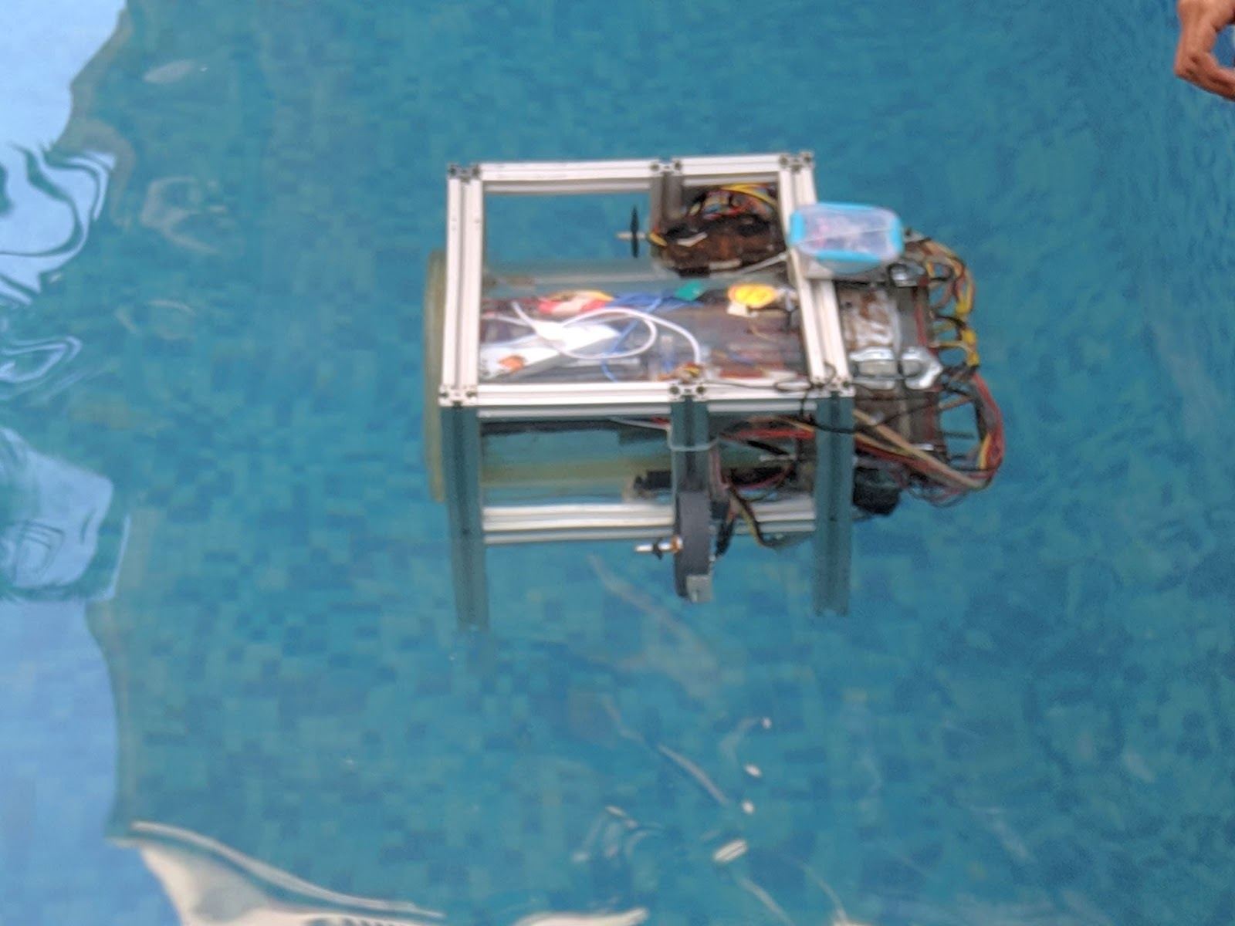
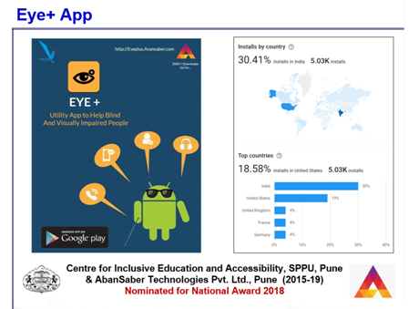
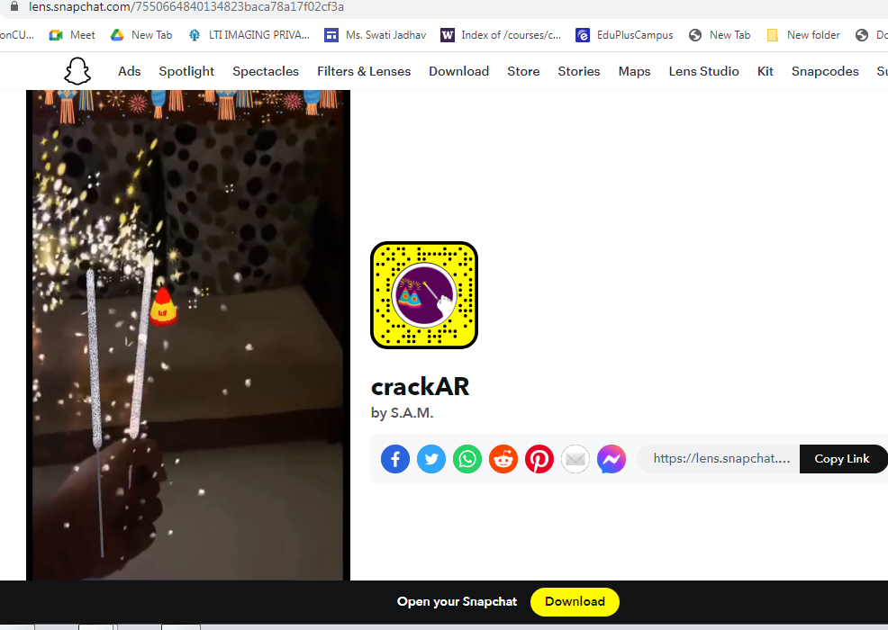
Product Development
Trident Lab-Underwater Robot
Snapchat Lens

Slide 62
Innovations in Teaching and Learning
Group Discussion
Quiz
Role Playing
Innovative Teaching Learning
Case Studies
Chorus
Response
Analogies
Think Break
Problem Solving

Slide 63
Faculty Participation in FDPs/ STTPs/Workshops
Academic Year | > 5 Days | 2 to 5 Days | Assessment
CAYm1 (2020-21) | 17 | 0 | 11.86
CAYm2 (2019-20) | 12 | 6 | 11.70
CAYm3 (2018-19) | 18 | 5 | 18.00
Average |  |  | 13.85
63

Slide 64
Academic Research
Type of Publication | 2019-20 | 2020-21 | 2021-22 | Total
Journal | 17 | 21 | 08 | 46
Conference | 11 | 29 | 22 | 62
Book/Book Chapter | 07 | 12 | 07 | 26
Total Paper Publications | 35 | 62 | 37 | 134
Patent s / Copyrights | 03 | 09 | 22 | 34
Type of Publication | 2019-20 | 2020-21 | 2021-22 | Total
Journal (Scopus) | 2 | 4 | 2 | 8
Conference (Scopus) | 9 | 20 | 9 | 38
Book / Book Chapter (Scopus) | 3 | 2 | 6 | 11
SCI-indexed | 3 | 1 | 0 | 4
64

Slide 65
Sponsored Research and Consultancy
Sponsored Research
Sr. No. | Research Project Title | Duration | Funding Agency | Amount in INR
01 | Problems over Integer Lattices: a Study from Computational Complexity Perspect | 2021-24 | SERB, DST | 32,39,498
02 | Safety Application for Bicycle Rider | 2021-22 | SIGCHI & OFFIS, Germany | 65,314
03 | Use of ICT for Mothers of Preterm Infants | 2019-20 | African Academy of Sciences & India Alliance | 2,48,400
04 | Problems over Non-commutative Polynomial Rings: A study from Computational Complexity Perspect | 2019-22 | SERB, DST | 6,60,000
05 | Gyan Shodh - Knowledge Search Engine in Marathi Language with recognition of printed or handwritten Devanagari script as an input | 2018-21 | Rajiv Gandhi Science and Technology Commission | 36, 44, 175
Consultancy from Industry
Sr. No. | Name of the consultant | Name of the Project | Name of the Organization/ Company/ Institute | Duration of the project | Total amount received in INR
01 | Dr. S T Patil | Load and Quality Balance Management Support | Virtual Automations, Hyderabad | 2021-22 | Rs. 1,20,000 Sanctioned
02 | Prof. Sangeeta Lade | Preparation of DPR for Ready-Made Garment Cluster, Jintur | Govt of Maharashtra | 2019-21 | Rs. 2,50,000
65

Slide 66
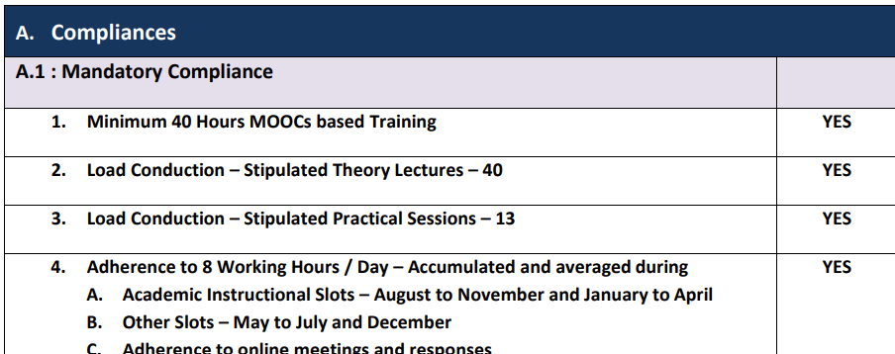
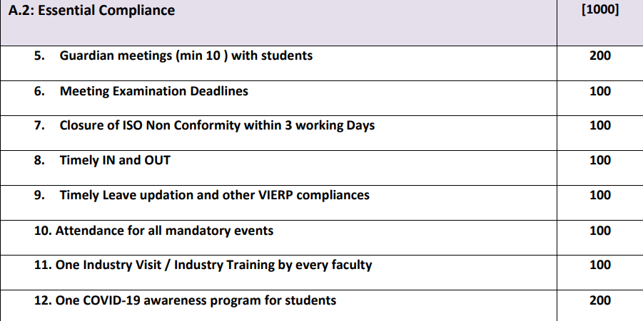
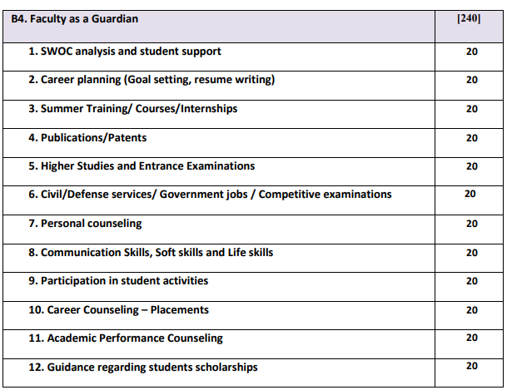
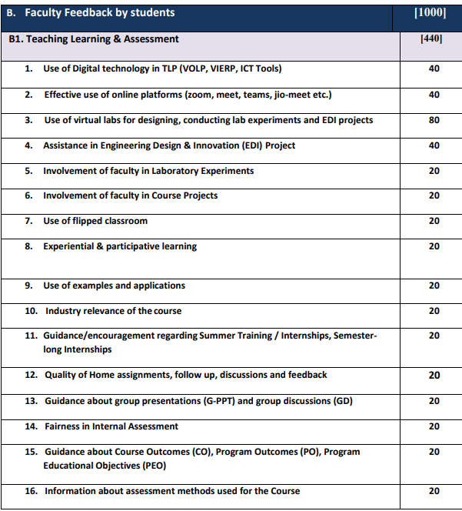
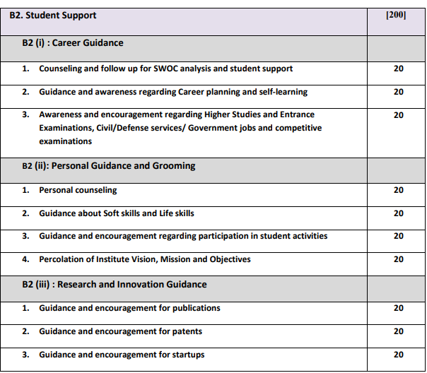
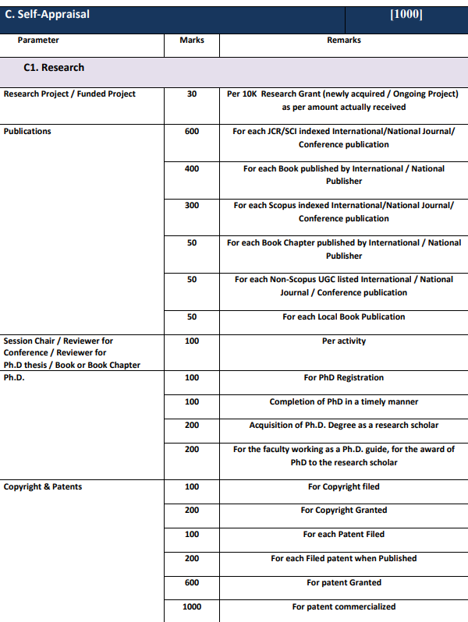
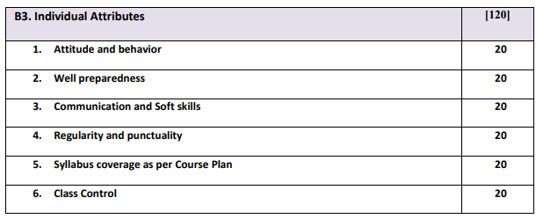
Faculty Performance Appraisal
*Academic Year 2020-21

Slide 67


Faculty Award and Achievements
Motivate faculty in different fields such as Research, Academics-well appraised teacher, Best guardian faculty
Well
Appraised
Teachers
Prestigious VIT SHREE Award on VIT Foundation Day
Rs.11000/- Cash + Felicitation + Certificate of Appreciation + Bronze Medal

Slide 68
Faculty Performance Appraisal and Awards
Sr No | Name of the Faculty | Institute Award Received | Month & Year | Award Details
01 | Dr. Pushkar S. Joglekar | VIT Shri | Sept 2019 | Research grant
02 | Dr. Pushkar S. Joglekar | VIT Shri | Sept 2020 | Research Publication
03 | Dr G D Bhutkar | Certificate of Appreciation | Oct 2021 | Book Publishing
04 | Dr G D Bhutkar | Certificate of Appreciation | Oct 2021 | Patent Publishing
Sr. No. | Name of the faculty | Award Received | Awarding Body | Date Awarded | Level: International/ National | Place Awarded | Details of the award, if any
1 | Dr. S. T. Patil | Gold plaque,Gold medal, Memento and certificate | International Institute for Social and Economic Reforms | March 2022 (2021-22) | International | Bangalore | Dr. APJ Abdul Lifetime Achievement Award for Research and Publications.
2 | Dr. S. T. Patil | Certificate | SIEMA | 27 March 2022 (2021-22) | International | Online | Outstanding Dissertation award 2022
3 | Dr G D Bhutkar | Best Paper Award | Asian CHI | April, 20120 (2019-20) | International | Hawaii (USA) (Online) | Certificate

Slide 69







Faculty Academic Visits…
Europe:
SIGCHI
IFIP
SIGCHI
BINUS
AAS
IPID
Asia:
Africa:
Total Amount of Travel Grant (2018-22) = USD 7000

Slide 70
Visiting / Adjunct Faculty
Sr No | Name of Adjunct Faculty | Academic Year | Hours of Interaction | Role & Responsibility
01 | Prof Amol Sawant | 2021-22 | 72 | Course Teacher - Cloud Computing & Theory of Computation
02 | Prof Dipti Gogawale | 2021-22 | 72 | Course Teacher- Cloud Computing & Data Structures
03 | Prof Prasad Bhosale | 2020-21 | 52 | Student Training Program & FDP Coordinator
04 | Prof Shiv Sutar | 2019-20 | 120 | Course Teacher - Compiler Construction
Sr No | Name of Company (Visiting Faculty) | Academic Year | Hours of Interaction | Courses Taught
01 | Credit Suisse | 2019-20 | 35 | Financial Technology
02 | John Deere | 2018-19 | 35 | Agile Methodology, AngularJs, DevOps

Slide 71

Corrective Actions for Underperforming Faculty
Faculty obtaining FPI below score of 75 are identified
Representative Examples of Faculty Performance Improvement
NPTEL MOOC training
Deputation to FDPs
Discussion and counselling by Head
Institute level Discussion by Director
Training is offered in areas such as:
Pedagogy, Technical contents, Soft skills
FPI is further linked with overall faculty appraisal
Further appreciation
Corrective actions
Counseling by Head, Dean Academics and Director

Slide 72
Visiting / Adjunct /Emeritus Faculty
Sr. No. | Academician / Industry Person | Designation | Academic Year | Total Hrs. Engaged
1 | Shiv Sutar | Adjunct faculty | 2019-20 | 120
2 | Prasad Bhosale | Adjunct faculty | 2020-21 | 52
3 | Dipti Gogawale | Adjunct faculty | 2021-22 | 72
4 | Amol Sawant | Adjunct faculty | 2021-22 | 72
5 | Credit Suise experts | Visiting Faculty | 2019-20 | 35
6. | John Deer Experts | Visiting Faculty | 2018-19 | 35
72

Slide 73
Departmental Infrastructure
73

Slide 74
Departmental Infrastructure Resources
Sr. No. | Room Description | Count
1 | Classrooms | 9
2 | Laboratories | 12
3 | Seminar Hall | 1
4 | Faculty Cabins/Cubicles | 15+26
5 | HOD Cabin | 1
6 | Departmental Library | 1
74

Slide 75
Laboratories
Sr. No. | Name of Laboratory | Investment Cost In Rupees.
1 | Research Lab (1316D) | 1959045
2 | Information Access Centre (1318) | 350000
3 | Nvidia Visual Computing Lab (1321A) | 1712000
4 | Network Lab (1321D) | 1790000
5 | System Software Lab (1323A) | 5964105
6 | IOT Lab (1323D) | 568919
7 | Data Science Lab (1326) | 559705
8 | Software Engineering Lab (1327) | 569300
9 | Human-Computer Interaction Lab (1329) | 570600
10 | Project Lab (1207) | 729440
11 | AR/VR Lab (1208) | 156365
12 | Computer Vision Lab (1209) | 527500
 | Total Investment | 15456979
75

Slide 76
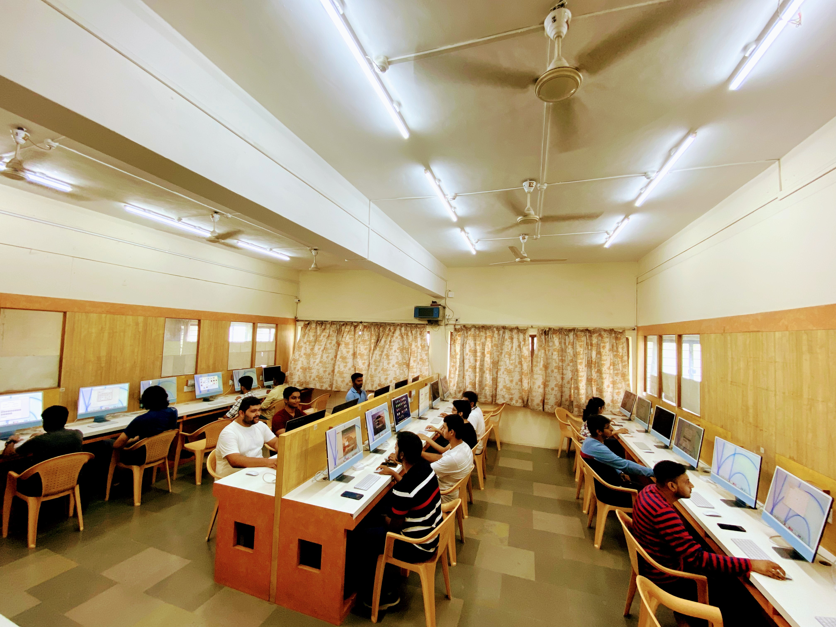
Snapshots of Laboratories
Apple iMAC M1 Series –High Computing Facility to students
NVIDIA VISUAL COMPUTING LAB
76

Slide 77
Continuous Improvement
77

Slide 78
Admissions
Item |  | 2021-22 | 2020-21 | 2019-20
National Level Entrance Examination (Name of the Entrance Examination) (JEE) | No. of Students admitted | 10 | 32 | 34
 | Opening Rank | 97.101 (918) | 97.628 (395) | 98.855 (458)
 | Closing Rank | 96.248(1340) | 96.549 (754) | 97.815 (1163)
State/University/Level Entrance Examination/Others (Name of the Entrance Examination ( CET) | No. of Students admitted | 277 | 262 | 264
 | Opening Rank | 99.526 (602) | 99.759(323) | 99.875 (221)
 | Closing Rank | 72.572 (40393) | 74.486(35737) | 61.020(47175)
Name of the Entrance Examination for Lateral Entry or lateral entry details (Diploma) | No. of Students admitted | 42 | 39 | 32
 | Opening Rank | 98.80% (37) | 96.17% (265) | 93.06% (274)
 | Closing Rank | 87.14% (15530) | 63.80% (49737) | 63.13% (42797)
78

Slide 79
Admissions
79

Slide 80
Improvement in the Quality of students admitted to the programs
Academic Year | 2018-19 | 2019-20 | 2020-21 | 2021-22
Opening score | 165(* Merit marks) | 99.04655 | 99.4388 | 99.1859312

Slide 81
Success Index
Year of Graduate
Year of Graduate
Average SI =0.58
Success Index without Backlog
Average SI =0.93
Success Index with Backlog

Slide 82
Academic Performance Index
Year of Graduate
Average API Second Year = 8.34

Slide 83
Department Toppers
Name of Student | A.Y.
Tabish Ahmad Nisar Ahmad | 2011-12
Vartak Shraddha Anil | 2012-13
Oswal Shivam Valchand | 2013-14
Kabara Pratik Shrikant | 2014-15
Doshi Pratiti Jitendra | 2015-16
Supekar Nikhil Vinayak | 2016-17
Gadhe Sampada Murlidhar | 2017-18
Shaikh Rehan Ahmed Ejaz | 2018-19
Oswal Shreya Jeetendra | 2019-20
Mote Shubham Dnyandev | 2020-21
Yashwardhan Bhangdia | 2021-22

Slide 84












Placements( Need to be updated)
Year | CAYm1 (2018-19) | CAYm2 (2019-20) | CAYm (2020-21)
Total Students | 221 | 188 | 170
Students Placed | 194 | 149 | 127
% of Students Placed | 75% | 79% | 88%
Avg. Salary(LPA) | 7.12LPA | 8.62LPA | 8.89LPA
Max Salary(LPA) | 18LPA | 26.4LPA | 33.75LPA
84

Slide 85
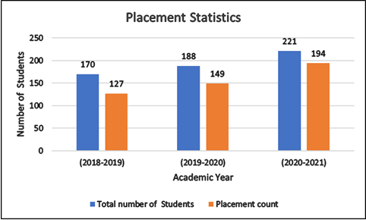
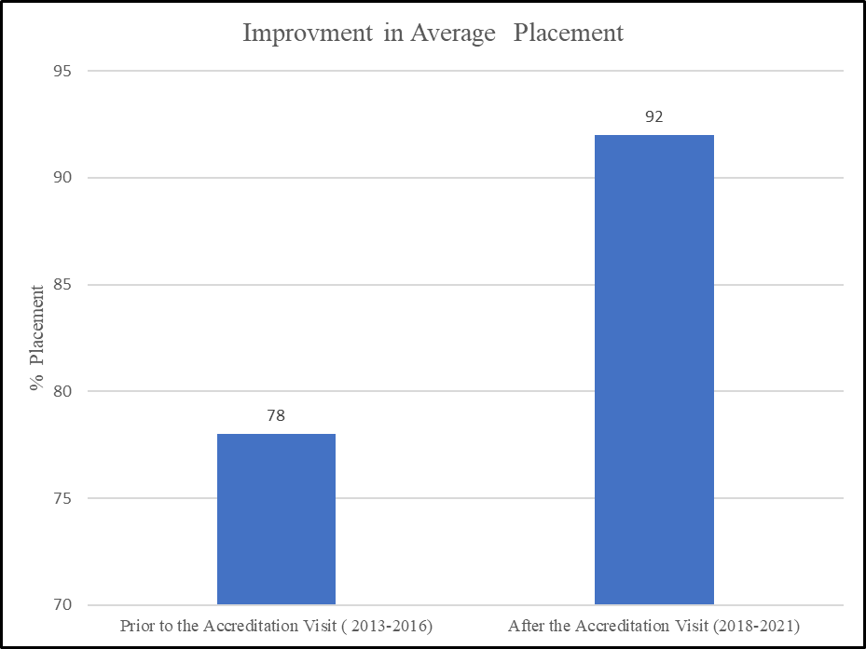
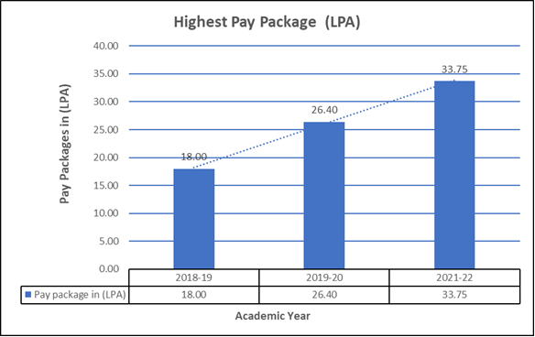
Placement

Slide 86
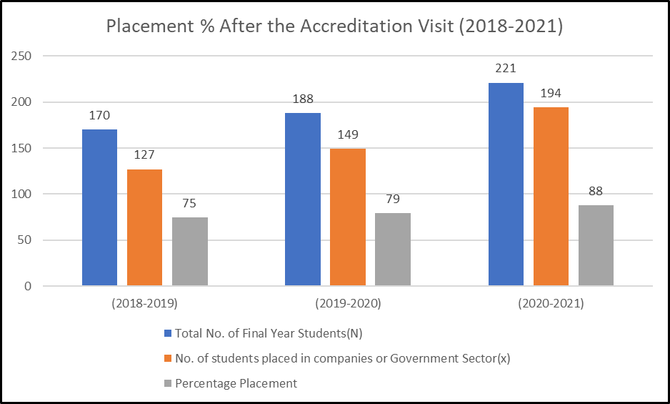
Placement

Slide 87
Higher Studies & Entrepreneurship
Academic Year | CAYm1 (2020-21) | CAYm2 (2019-20) | CAYm3 (2018-19)
No. of Students Admitted for Higher Studies | 15 | 19 | 28
Year of Passing | Name of the Student | Name of Start Up
2018-19 | Abhishek Bihani | RS Enterprises
 | Harnur Virk | Symbiotic Digital Solutions Pvt Ltd
2019-20 | Rishi Thole | Rathi Steel India Pvt Ltd.
2020-21 | Arya Bhivpathki | Reticulo Sports Technology Incubation Centre
 | Vaibhav Gambhire | Self Employed
2021-22 | Anushka Bhave | Fem Health (PCOS Virgo)
 | Aryan Shaikh | Aryahs World

Slide 88
PO Attainment
88

Slide 89
Last NBA Visit Status
NBA Cycle | Visit Dates/ Result Date | Accreditation Period | (UG) Score
Last NBA | 25-27 November 2016 | 3 years | 772
NBA Extension | 2019 | 3 years | NA
89

Slide 90
SWOC Analysis and Future Plans
Strengths:
Effective Teaching – Learning Process
Experienced and qualified faculty
Good Industry Institute Interaction
Funded research projects
Quality Publication
International collaborations
Opportunities:
Research Grants and Research Funding from external agencies
Collaboration with more industries
Challenges:
Dynamic changes in technology
Rate of obsolescence in IT field and matching curriculum to meet these
Weakness:
consultancy need to be improved
Future Plans:
To enhance faculty qualification
To strengthen association with industry for partial content delivery, internship, placement
To enhance the average package of students
To increase funded research projects and consultancy
To collaborate with foreign universities for student and faculty exchange program.
90

Slide 91
Compliance Status
Sr. No | Parameter | Criteria | Observations | Remarks of The Evaluator
 | Observation on the overall compliance to the deficiencies mentioned by the previous Visiting team | Criteria 1 | More Awareness is needed among stakeholders. | Compiled
2. |  | Criteria 2 | More Scientific based curriculum development approach may be used by involving stake holders of the programme | Compiled
3. |  | Criteria 3 | Data analysed for the CO attainment is shown only for the one academic Year (2015-16 Only).Data Analysed for PO attainment is shown only for the one academic year (2015-16) only | Compiled
4. |  | Criteria 4 | Students success rate is low, Number of students without backlog is low .Academic performance index is low Placement. | Compiled
5. |  | Criteria 5 | Faculty Cadre proportion is low as more number of assistant professors are present. Less number of faculty is having Ph.D Qualifications | In process
6. |  | Criteria 7 | Gaps are not properly identified. Placement is reduced as students are going for higher study. | Compiled

Slide 92
Sr.No | Criteria | Prior to the Accreditation Visit | After the Accreditation Visit
 | Improvement in the number of Faculty Development program (FDP) Attended | 134 | 173
2 | Improvement in the number of Publications | 102 | 158
3 | Quality of Publications | Number of papers in Non-SCI: 22 SCI/ESCI:05 SCOPUS:32 IEEE/ IET Conference:21 Books/Books Chapter: 12 Patent/ Copyright:10 Total: 102 | Number of papers in Non-SCI: 45 SCI/ESCI: 05 SCOPUS: 56 IEEE/IET Conference: 53 Book/Books Chapter :26 Patent/ Copyright: 34 Total Publication: 158
4 | Amount Funded Research received | 26,70,440/- | 78,57,387/-
5 | Placement | 62.43% | 92%
6 | Intake | 150 | 240
7 | Infrastructure | - | APPLE IMAC M1 Series High Performance Computing facility. Laptops with Adequate Hardware and Software Configuration.

Slide 93


